Slide 1
PrivateRide: A Privacy-Enhanced Ride-Hailing Service
Anh Pham¹, Italo Dacosta¹, Bastien Jacot-Guillarmod¹, Kévin Huguenin², Taha Hajar¹, Florian Tramèr³, Virgil Gligor⁴, and Jean-Pierre Hubaux¹
¹EPFL, ²UNIL, ³Stanford, ⁴CMU

Slide 2
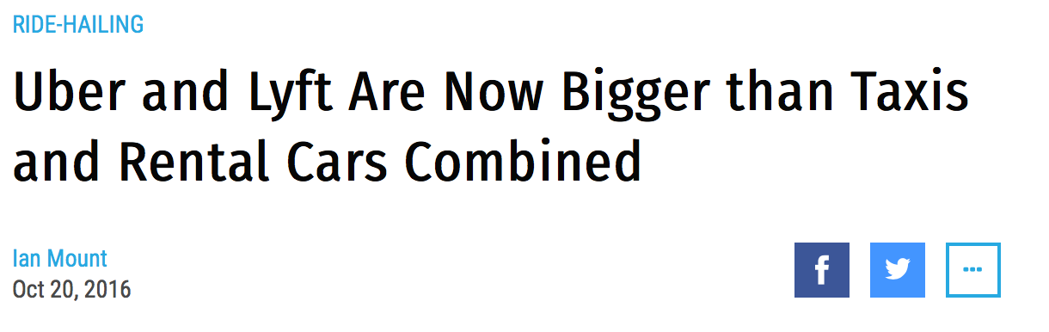
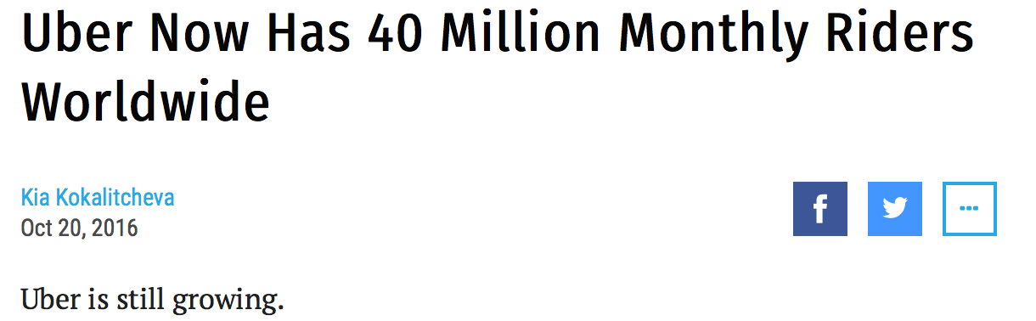

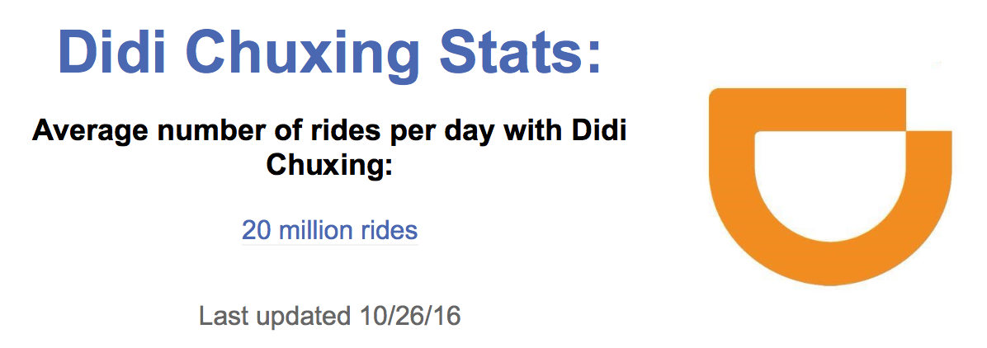
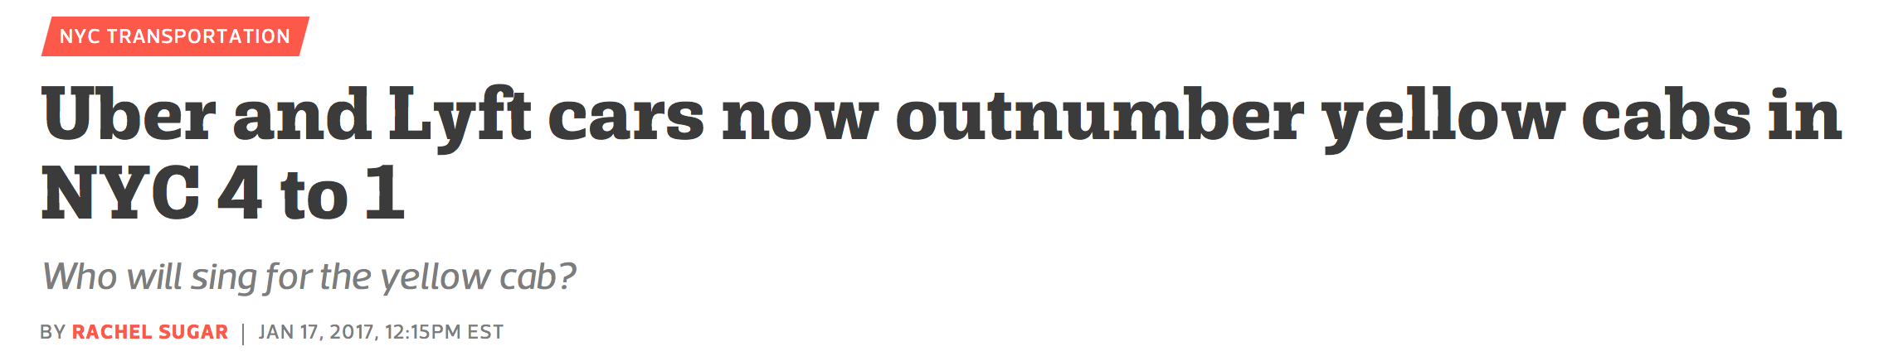
Ride-Hailing Services (RHSs)
Millions of users, billions of rides, hundreds of cities

Slide 3
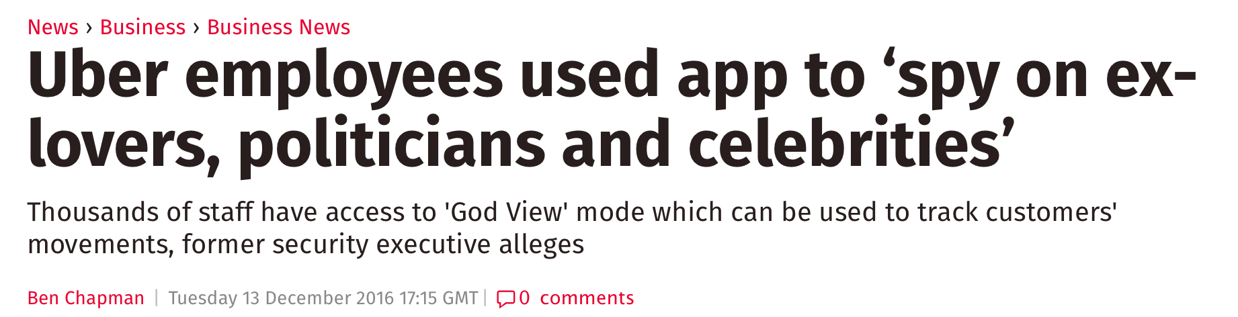
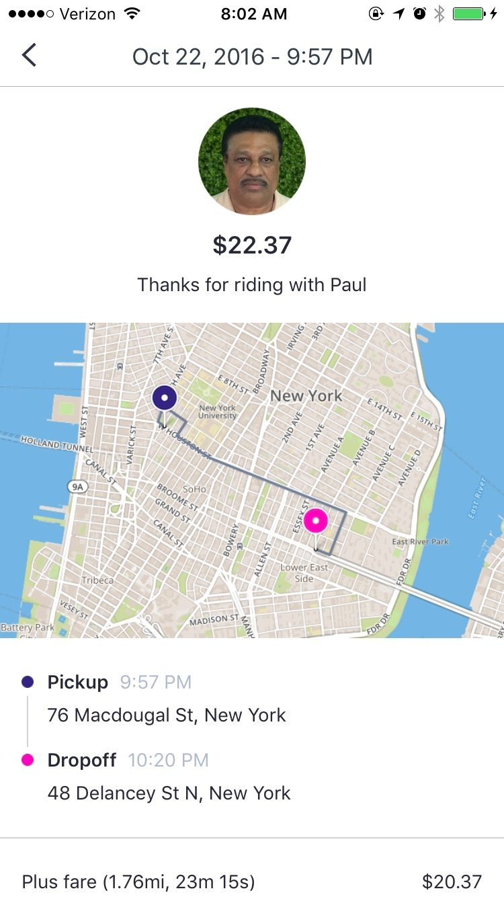

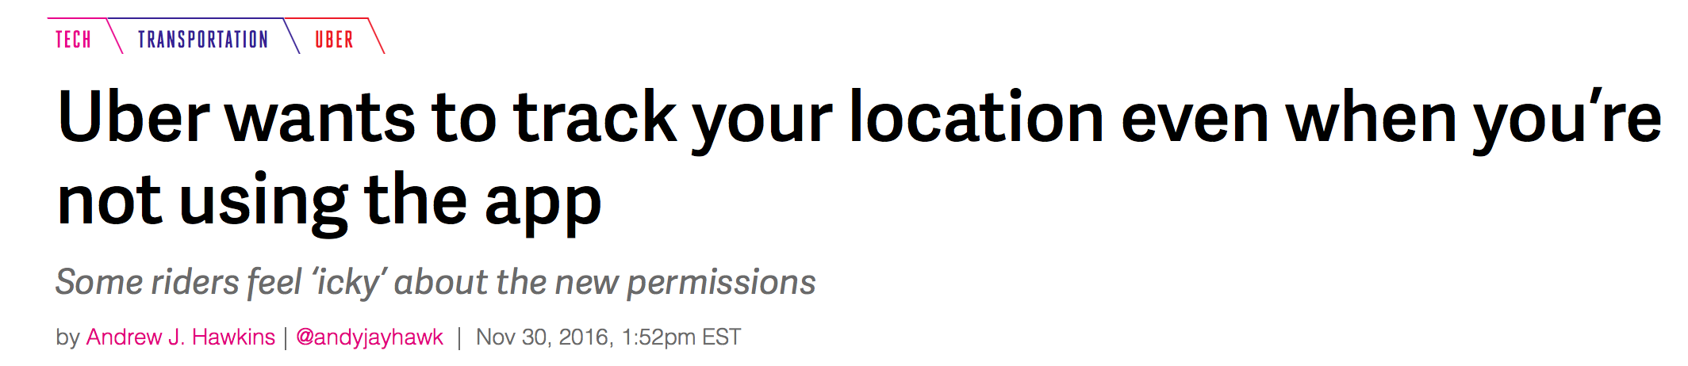
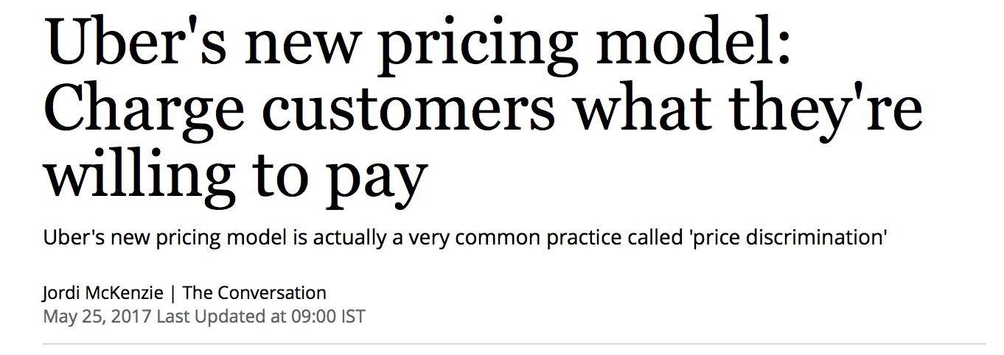
Service providers track riders’ locations

Slide 4
Our contributions
The first general privacy analysis of RHSs
  Identified high-risk threats
PrivateRide: the first solution that addresses the identified threats
Privacy and performance evaluation of PrivateRide

Slide 5





RHS overview
Match riders and drivers
Compute fares
Handle payment
Provide reputation system
Service
Provider (SP)
Internet
Riders (R)
Drivers (D)
Request rides
Offer rides
Notes:
Some other variations. This is the most common setup.

Slide 6
Threat model
SP
Honest-but-curious
Outsider (O)
Active
Internet
Riders (R)
Drivers (D)
Active
Active

Slide 7



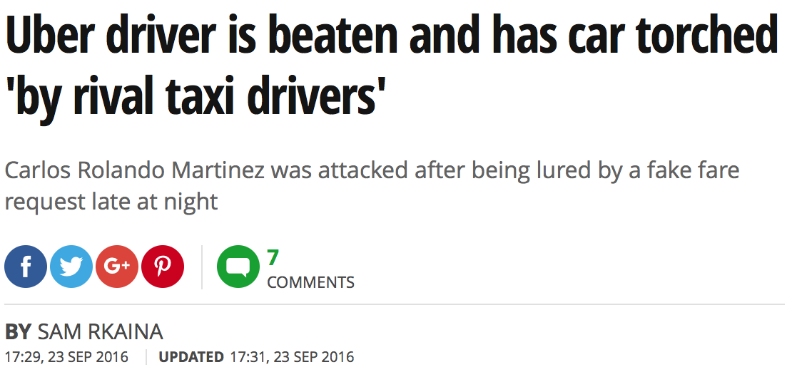
Privacy analysis: high-risk threats
SP tracks riders’ locations
Outsider harvests drivers’ PII
SP database
Rider’s real identity
Precise pickup and drop-off locations
Precise pickup and drop-off times
Full location trace
Fare
Driver’s real identity
SP
ID₁, Location X
ID₂, Location Y
Closest drivers’ info
Cancel
Internet
Outsider (O)

Slide 8

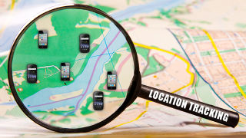





PrivateRide: Goals
No riders’ location tracking
No drivers’ PII harvesting
  SP economic incentives
  Usability
  Payment and reputation operations
  Accountability
while preserving:
PrivateRide

Slide 9


Overall protocol
Secure channel
Proximity channel
Rider: Bob
(anonymously logged in using an AC)
SP
cert_{Bob}
e-cash
ACs
Driver: Alice
(1) zone₁
cert_{Alice}
Ride initiation
Driver: Dave
(2) zone₃, e-cash deposit
(1) zone₂
cert_{Dave}
(3) Match to the closest driver (Alice)
(4) Build a secure channel, exchange locations, rep_{Bob}, generate a PIN
Alice drives to pick up Bob
(5) Alice’s locations in real time
In proximity of the pick-up location
(6) Proximity check using PIN
(7) Identifying info: vehicle’s info., Alice’s profile picture
(8) Build and exchange reputation tokens
During the ride
(9) loc. b/w zone₃ and drop-off zone
End of the ride
(11) Charge from deposit
(10) Done
(12b) Anonymously rate Alice
(12a) Anonymously rate Bob

Slide 10
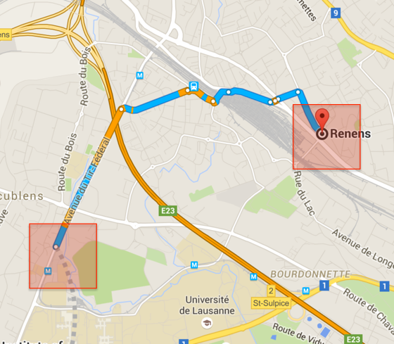
Protocol analysis:
PrivateRide vs. current RHSs
 | Identities | Pick-up loc. | Pick-up time | Drop-off loc. | Drop-off time | Loc. trace | Fare
Current RHSs | Rider, Driver | Precise | Precise | Precise | Precise | Full | Yes
PrivateRide | Driver | Zone | Obfuscated | Zone | Obfuscated | Partial | Yes

Slide 11
Evaluation
Data-sets
  NYC taxi rides:
    Pick-up, drop-off locations and times, drivers’ info.
  SF Uber rides:
    Truncated anonymous GPS traces
Evaluation criteria
  Cryptographic overhead
  Privacy level (k-anonymity) [NYC]
  Effect of the size of the zones on
    Fare calculation [SF]
    Optimality of ride matching [NYC]

Slide 12
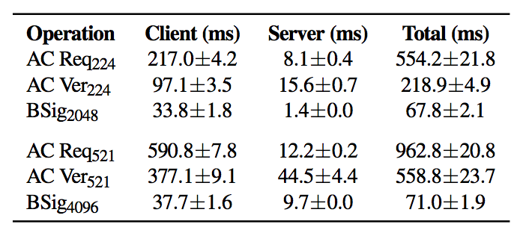
Cryptographic overhead
A prototype Android¹ client
  ACL² operations
  Blind and standard signatures
  Security parameters:
    ACL with an EC group of 521 bits and 4096-bit RSA keys
    ACL with an EC group of 224 bits and 2048-bit RSA keys
Negligible w.r.t. waiting
time of minutes in RHSs
¹ LG G3 (4x2.5 GHz, 2GB RAM) running Android 5.0
² F. Baldimtsi and A. Lysyanskaya. Anonymous Credentials Light, CCS (2013)

Slide 13
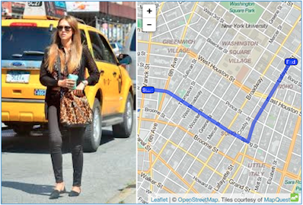
Privacy guarantees
Measured by k-anonymity
Targeted attack by a powerful SP:
  Knows the pick-up location and time of
  a specific rider
  Wants to know the drop-off location
General case:
  Knows riders’ home/work addresses
  Wants to profile riders’ activities

Slide 14
Privacy guarantees – targeted attacks by powerful SP
For peak hour: 7 PM – 8 PM
For least-busy hour: 4 AM – 5 AM
  For zones of size 600 m x 600 m:
  60% of rides has anonymity set ≥ 7 during peak hour
  50% of rides has anonymity set ≥ 2 during least-busy hour

Slide 15
Conclusions
The first analysis about privacy threats in RHSs
The first privacy-enhancing solution for RHSs
  Negligible delay for ride-hailing operations
  Enhanced location privacy for riders
  Harvesting attacks on drivers’ PII are prevented
  Limitations:
  Trade-off between anonymity sets and accuracy of ride-matching operations
  Require riders to obtain e-cash in advance
  Follow-up work: ORide³ protocol at USENIX Security Symposium 2017
³http://oride.epfl.ch

