Slide 1


Personalized Pseudonyms for Servers in the Cloud
Qiuyu Xiao (UNC-Chapel Hill)
Michael K. Reiter (UNC-Chapel Hill)
Yinqian Zhang (Ohio State Univ.)

Slide 2


Background
User’s privacy is not well protected with the normal HTTPS connection.
DNS query
Query name:
www.example.com
IP
TCP
TLS/SSL
Encrypted payload
SNI: example.com
Certificate subject name: example.com
Pub key: E58B2C78…..
IP address: 111.111.111.111

Slide 3
Background
User’s privacy is not well protected with the normal HTTPS connection.
DNS query
Query name:
www.example.com
IP
TCP
TLS/SSL
Encrypted payload
SNI: example.com
Certificate subject name: example.com
Pub key: E58B2C78…..
IP address: 111.111.111.111

Slide 4
Background
User’s web browsing actions are monitored by various parties.

Slide 5

Background
User’s web browsing actions are monitored by various parties.

Slide 6
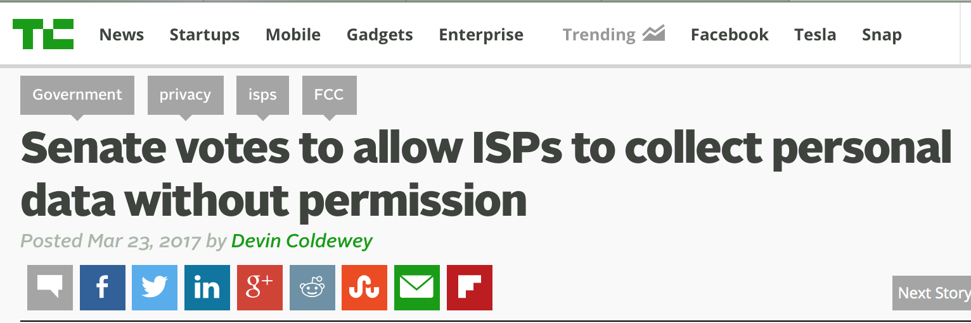
Background
User’s web browsing actions are monitored by various parties.

Slide 7
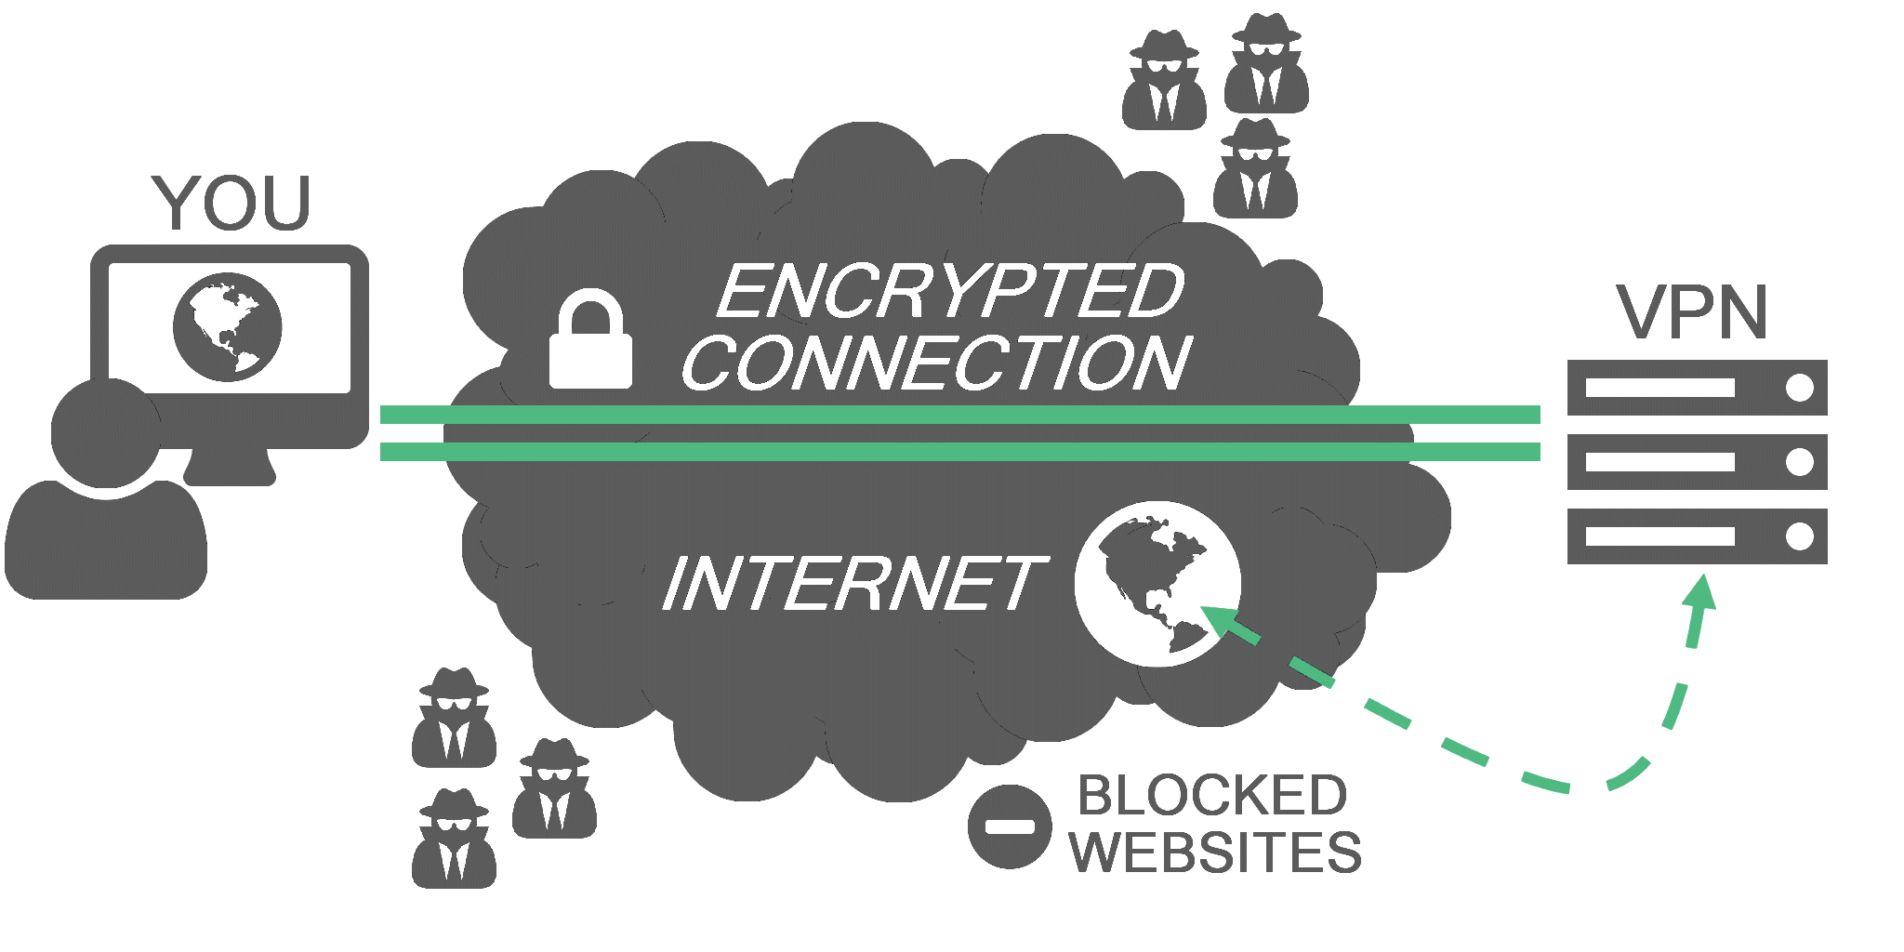
Existing solutions
VPN tunneling
  Encrypt and tunnel user’s traffic through proxy server

Slide 8
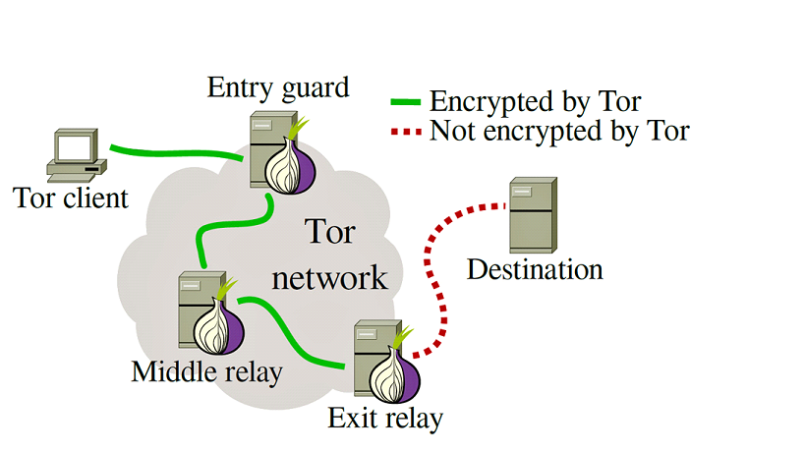
Existing solutions
Tor
  Route encrypted packets through multiple Tor relays

Slide 9
Existing solutions
Cloud and CDN based solutions
  CloudTransport^{[1]}
  Domain fronting^{[2]}
  CacheBrowser^{[3]}
Cloud-Transport: Using cloud storage for censorship-resistant networking, PETS 2014
Blocking-resistant communication through domain fronting, PETS 2015
CacheBrowser: Bypassing Chinese censorship without proxies using cached content, CCS 2015

Slide 10
Existing solutions
Cloud and CDN based solutions
  CloudTransport^{[1]}
  Domain fronting^{[2]}
  CacheBrowser^{[3]}
non-cooperative cloud provider
Cloud-Transport: Using cloud storage for censorship-resistant networking, PETS 2014
Blocking-resistant communication through domain fronting, PETS 2015
CacheBrowser: Bypassing Chinese censorship without proxies using cached content, CCS 2015

Slide 11
Existing solutions
Cloud and CDN based solutions
  CloudTransport^{[1]}
  Domain fronting^{[2]}
  CacheBrowser^{[3]}
Domain name is visible in TLS SNI field
Cloud-Transport: Using cloud storage for censorship-resistant networking, PETS 2014
Blocking-resistant communication through domain fronting, PETS 2015
CacheBrowser: Bypassing Chinese censorship without proxies using cached content, CCS 2015

Slide 12
Our solution
Personalized Pseudonym for a Server in the Cloud (PoPSiCl)
DNS query
Query name:
www.example.com
IP
TCP
TLS/SSL
Encrypted payload
SNI: example.com
Certificate subject name: example.com
Pub key: E58B2C78…..
IP address: 111.111.111.111

Slide 13

Our solution
Personalized Pseudonym for a Server in the Cloud (PoPSiCl)
DNS query
Query name:
www.example.com
IP
TCP
TLS/SSL
Encrypted payload
SNI: example.com
Certificate subject name: example.com
Pub key: E58B2C78…..
IP address: 111.111.111.111
Notes:
PoPSiCl is a service provided by a cooperative cloud provider. Try to protect server anonymity for tenant servers in cloud.

Slide 14
Our solution
Personalized Pseudonym for a Server in the Cloud (PoPSiCl)
DNS query
Query name:
x…x.popsicls.com
IP
TCP
TLS/SSL
Encrypted payload
SNI: x…x.popsicls.com
Certificate subject name: x…x.popsicls.com
Pub key: AGJ46DM…..
IP address: 124.132.215.121
Notes:
PoPSiCl is a service provided by a cooperative cloud provider. Try to protect server anonymity for tenant servers in cloud.
PoPSiCl is a pseudo domain name. PoPSiCl, Public key, IP address are independent from tenant server’s identity.

Slide 15
Our solution
Personalized Pseudonym for a Server in the Cloud (PoPSiCl)
DNS query
Query name:
x…x.popsicls.com
IP
TCP
TLS/SSL
Encrypted payload
SNI: x…x.popsicls.com
Certificate subject name: x…x.popsicls.com
Pub key: AGJ46DM…..
No extra client application!
IP address: 124.132.215.121
Notes:
PoPSiCl is a service provided by a cooperative cloud provider. Try to protect server anonymity for tenant servers in cloud.
PoPSiCl is a pseudo domain name. PoPSiCl, Public key, IP address are independent from tenant server’s identity.
It is compatible with all major browsers

Slide 16
Our solution
Personalized Pseudonym for a Server in the Cloud (PoPSiCl)
DNS query
Query name:
x…x.popsicls.com
No proxy!
IP
TCP
TLS/SSL
Encrypted payload
SNI: x…x.popsicls.com
Certificate subject name: x…x.popsicls.com
Pub key: AGJ46DM…..
No extra client application!
IP address: 124.132.215.121
Notes:
PoPSiCl is a service provided by a cooperative cloud provider. Try to protect server anonymity for tenant servers in cloud.
PoPSiCl is a pseudo domain name. PoPSiCl, Public key, IP address are independent from tenant server’s identity.
It is compatible with all major browsers
Does not require intermediate proxy relay. It is faster.

Slide 17
Threat model
In the context of a client-server interaction …
What is trusted
  Client computer
  Cloud infrastructure (including the server computer)
What is not trusted
  The network between the client and the cloud
  Other clients and other servers

Slide 18
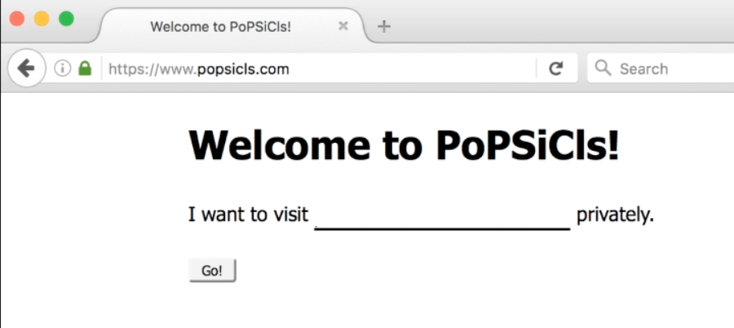
PoPSiCl registration
www.example.com

Slide 19
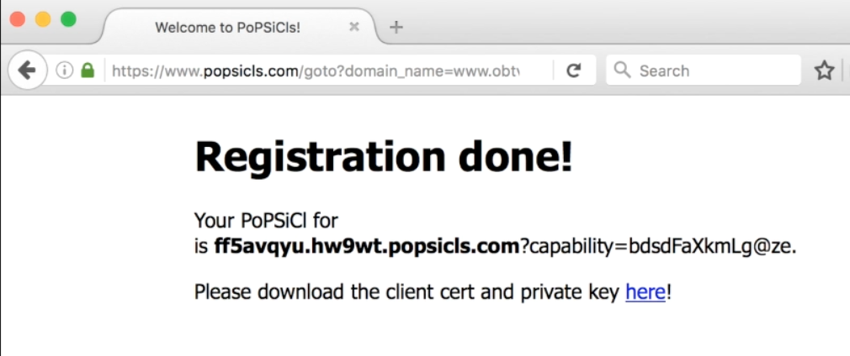
PoPSiCl registration
www.example.com

Slide 20

PoPSiCl registration
VM
VM
VM
VM
DNS server
VM
VM
PoPSiCl store
SDN controller

Slide 21
PoPSiCl registration
VM
VM
VM
VM
DNS server
VM
VM
PoPSiCl store
Registration request
SDN controller

Slide 22
PoPSiCl registration
PoPSiCl
Pseudo IP
VM
VM
VM
VM
DNS server
VM
VM
PoPSiCl store
SDN controller

Slide 23
PoPSiCl
PoPSiCl registration
Pseudo IP
PoPSiCl
Tenant server ID
VM
VM
VM
VM
DNS server
VM
VM
PoPSiCl store
SDN controller

Slide 24
PoPSiCl
PoPSiCl registration
Pseudo IP
Client Cert
Server Cert
VM
VM
Client PriKey
Server PriKey
VM
VM
DNS server
VM
VM
PoPSiCl
PoPSiCl store
Tenant server ID
SDN controller

Slide 25
PoPSiCl
PoPSiCl registration
Pseudo IP
Sign
Cloud PriKey
Client Cert
Server Cert
VM
VM
Client PriKey
Server PriKey
VM
VM
DNS server
VM
VM
PoPSiCl
PoPSiCl store
Tenant server ID
SDN controller

Slide 26
PoPSiCl
PoPSiCl registration
Pseudo IP
Sign
Server PriKey
Client Cert
Server Cert
VM
VM
Client PriKey
VM
VM
DNS server
VM
VM
PoPSiCl
PoPSiCl store
Tenant server ID
SDN controller

Slide 27
PoPSiCl
PoPSiCl registration
Pseudo IP
PoPSiCl
PoPSiCl
Client Cert
Server Cert
VM
VM
Client PriKey
Server PriKey
VM
VM
DNS server
VM
VM
PoPSiCl
PoPSiCl store
Tenant server ID
SDN controller

Slide 28
PoPSiCl
PoPSiCl
PoPSiCl registration
Pseudo IP
Server Cert
PoPSiCl
Server PriKey
Client Cert
VM
VM
Client PriKey
VM
VM
DNS server
VM
VM
PoPSiCl
PoPSiCl store
Tenant server ID
SDN controller

Slide 29
PoPSiCl
PoPSiCl
PoPSiCl registration
Pseudo IP
Server Cert
Server PriKey
PoPSiCl
VM
VM
VM
VM
DNS server
Client Cert
VM
VM
PoPSiCl
Client PriKey
PoPSiCl store
Tenant server ID
SDN controller

Slide 30

PoPSiCl
PoPSiCl access
Pseudo IP
VM
VM
VM
VM
VM
VM
DNS server
PoPSiCl
PoPSiCl
Server Cert
Client Cert
Server PriKey
Client PriKey
SDN switch
PoPSiCl
Tenant server ID
SDN controller

Slide 31
PoPSiCl
PoPSiCl access
Pseudo IP
VM
VM
VM
VM
VM
VM
(1) DNS query:
PoPSiCl
DNS server
PoPSiCl
PoPSiCl
Server Cert
Client Cert
Server PriKey
Client PriKey
SDN switch
PoPSiCl
Tenant server ID
SDN controller

Slide 32
PoPSiCl
PoPSiCl access
Pseudo IP
VM
VM
VM
VM
VM
VM
(1) DNS query:
PoPSiCl
DNS server
PoPSiCl
PoPSiCl
Server Cert
(2) DNS response:
Pseudo IP
Server PriKey
Client Cert
Client PriKey
SDN switch
PoPSiCl
Tenant server ID
SDN controller

Slide 33
PoPSiCl
PoPSiCl access
Pseudo IP
VM
VM
VM
VM
VM
VM
(1) DNS query:
PoPSiCl
DNS server
PoPSiCl
PoPSiCl
Server Cert
(2) DNS response:
Pseudo IP
Server PriKey
Client Cert
Client PriKey
(3) Pseudo IP
SDN switch
PoPSiCl
Tenant server ID
SDN controller

Slide 34
PoPSiCl
PoPSiCl access
Pseudo IP
VM
VM
VM
VM
VM
VM
(1) DNS query:
PoPSiCl
DNS server
PoPSiCl
PoPSiCl
Server Cert
(2) DNS response:
Pseudo IP
Server PriKey
Client Cert
Client PriKey
(3) Pseudo IP
(4) Forward
SDN switch
PoPSiCl
Tenant server ID
SDN controller

Slide 35
PoPSiCl
PoPSiCl access
Pseudo IP
VM
VM
VM
VM
VM
VM
(1) DNS query:
PoPSiCl
DNS server
PoPSiCl
PoPSiCl
Server Cert
(2) DNS response:
Pseudo IP
Server PriKey
Client Cert
Client PriKey
(3) Pseudo IP
(4) Forward
SDN switch
PoPSiCl
(5) Establish TCP
(via SDN switch)
Tenant server ID
SDN controller

Slide 36
PoPSiCl
PoPSiCl access
Pseudo IP
VM
VM
VM
VM
VM
VM
(1) DNS query:
PoPSiCl
DNS server
PoPSiCl
PoPSiCl
Server Cert
(2) DNS response:
Pseudo IP
Server PriKey
Client Cert
Client PriKey
Get PoPSiCl from the SNI field in TLS ClientHello message.
(3) Pseudo IP
(4) Forward
SDN switch
PoPSiCl
(5) Establish TCP
(via SDN switch)
Tenant server ID
SDN controller

Slide 37
PoPSiCl
PoPSiCl access
Pseudo IP
VM
VM
VM
VM
VM
VM
(1) DNS query:
PoPSiCl
DNS server
PoPSiCl
PoPSiCl
Server Cert
(2) DNS response:
Pseudo IP
Server PriKey
Client Cert
Client PriKey
(3) Pseudo IP
(4) Forward
SDN switch
(6) Rule update
PoPSiCl
(5) Establish TCP
(via SDN switch)
Tenant server ID
SDN controller

Slide 38
PoPSiCl
PoPSiCl access
Pseudo IP
VM
VM
VM
VM
MATCH |  |  |  | ACTION
Source IP | Source port | Destination IP | Destination port
Client-IP | Client-port | Pseudo-IP | Server-port | Drop
Tenant-IP | Server-port | Client-IP | Client-port | Change source IP to Pseudo-IP
VM
VM
(1) DNS query:
PoPSiCl
DNS server
PoPSiCl
PoPSiCl
Server Cert
(2) DNS response:
Pseudo IP
Server PriKey
Client Cert
Client PriKey
(3) Pseudo IP
(4) Forward
SDN switch
(6) Rule update
PoPSiCl
(5) Establish TCP
(via SDN switch)
Tenant server ID
SDN controller

Slide 39
PoPSiCl
PoPSiCl access
Pseudo IP
VM
VM
VM
VM
VM
VM
(1) DNS query:
PoPSiCl
DNS server
PoPSiCl
PoPSiCl
Server Cert
(2) DNS response:
Pseudo IP
Server PriKey
Client Cert
Client PriKey
(3) Pseudo IP
(4) Forward
SDN switch
(7) TCP hand-off
(6) Rule update
PoPSiCl
(5) Establish TCP
(via SDN switch)
Tenant server ID
SDN controller

Slide 40
PoPSiCl
PoPSiCl access
Pseudo IP
VM
VM
VM
VM
VM
VM
(1) DNS query:
PoPSiCl
DNS server
PoPSiCl
PoPSiCl
Server Cert
(2) DNS response:
Pseudo IP
Server PriKey
Client Cert
Client PriKey
(3) Pseudo IP
(4) Forward
SDN switch
(7) TCP hand-off
(6)(8) Rule update
PoPSiCl
(5) Establish TCP
(via SDN switch)
Tenant server ID
SDN controller

Slide 41
PoPSiCl
PoPSiCl access
Pseudo IP
VM
VM
VM
VM
MATCH |  |  |  | ACTION
Source IP | Source port | Destination IP | Destination port
Client-IP | Client-port | Pseudo-IP | Server-port | Change destination IP to Tenant-IP
Tenant-IP | Server-port | Client-IP | Client-port | Change source IP to Pseudo-IP
VM
VM
(1) DNS query:
PoPSiCl
DNS server
PoPSiCl
PoPSiCl
Server Cert
(2) DNS response:
Pseudo IP
Server PriKey
Client Cert
Client PriKey
(3) Pseudo IP
(4) Forward
SDN switch
(7) TCP hand-off
(6)(8) Rule update
PoPSiCl
(5) Establish TCP
(via SDN switch)
Tenant server ID
SDN controller

Slide 42
PoPSiCl
PoPSiCl access
Pseudo IP
VM
VM
VM
VM
VM
VM
(9) TLS
(via SDN switch)
(1) DNS query:
PoPSiCl
DNS server
PoPSiCl
PoPSiCl
Server Cert
(2) DNS response:
Pseudo IP
Server PriKey
Client Cert
Client PriKey
(3) Pseudo IP
(4) Forward
SDN switch
(7) TCP hand-off
(6)(8) Rule update
PoPSiCl
(5) Establish TCP
(via SDN switch)
Tenant server ID
SDN controller

Slide 43
PoPSiCl
PoPSiCl access
Pseudo IP
VM
VM
Accept the connection only if the user can present a valid Client Cert
VM
VM
VM
VM
(9) TLS
(via SDN switch)
(1) DNS query:
PoPSiCl
DNS server
PoPSiCl
PoPSiCl
Server Cert
(2) DNS response:
Pseudo IP
Server PriKey
Client Cert
Client PriKey
(3) Pseudo IP
(4) Forward
SDN switch
(7) TCP hand-off
(6)(8) Rule update
PoPSiCl
(5) Establish TCP
(via SDN switch)
Tenant server ID
SDN controller

Slide 44
HTTP-specific mechanisms
Object linker
TenantA
TenantB

Slide 45
HTTP-specific mechanisms
Object linker
Hyperlink to TenantB via PoPSiCl?
TenantA
TenantB

Slide 46
HTTP-specific mechanisms
Object linker
Linker
TenantA
TenantB

Slide 47
HTTP-specific mechanisms
Object linker
Linker
TenantA
TenantB
Visit TenantA via its PoPSiCl

Slide 48
HTTP-specific mechanisms
Object linker
Linker
TenantA
TenantB
Hyperlink to TenantB with
https://linker.popsicls.com?tenantB.com/…

Slide 49
HTTP-specific mechanisms
Object linker
Linker
TenantA
TenantB
Request https://linker.popsicls.com?tenantB.com/…

Slide 50
HTTP-specific mechanisms
Check whether TenantA has the permission to link to TenantB.
Object linker
Linker
TenantA
TenantB

Slide 51
HTTP-specific mechanisms
Object linker
Linker
TenantA
TenantB
If TenantA has permission,
redirect to TenantB via its PoPSiCl

Slide 52
Other defenses against …
Cross-site request forgeries to deanonymize a PoPSiCL
Traffic analysis based on object sizes and number of objects
  Only have a partial solution here
(Please see paper)

Slide 53
Implementation
Cloud
OpenStack-based IaaS cloud deployed in CloudLab testbed
PoPSiCl store and SDN controller are implemented in C/C++
Open vSwitch as the SDN switch in each physical machine
Tenant server
A Linux kernel module for TCP state transfer
Each PoPSiCl is mapped to a virtual host in Nginx server

Slide 54
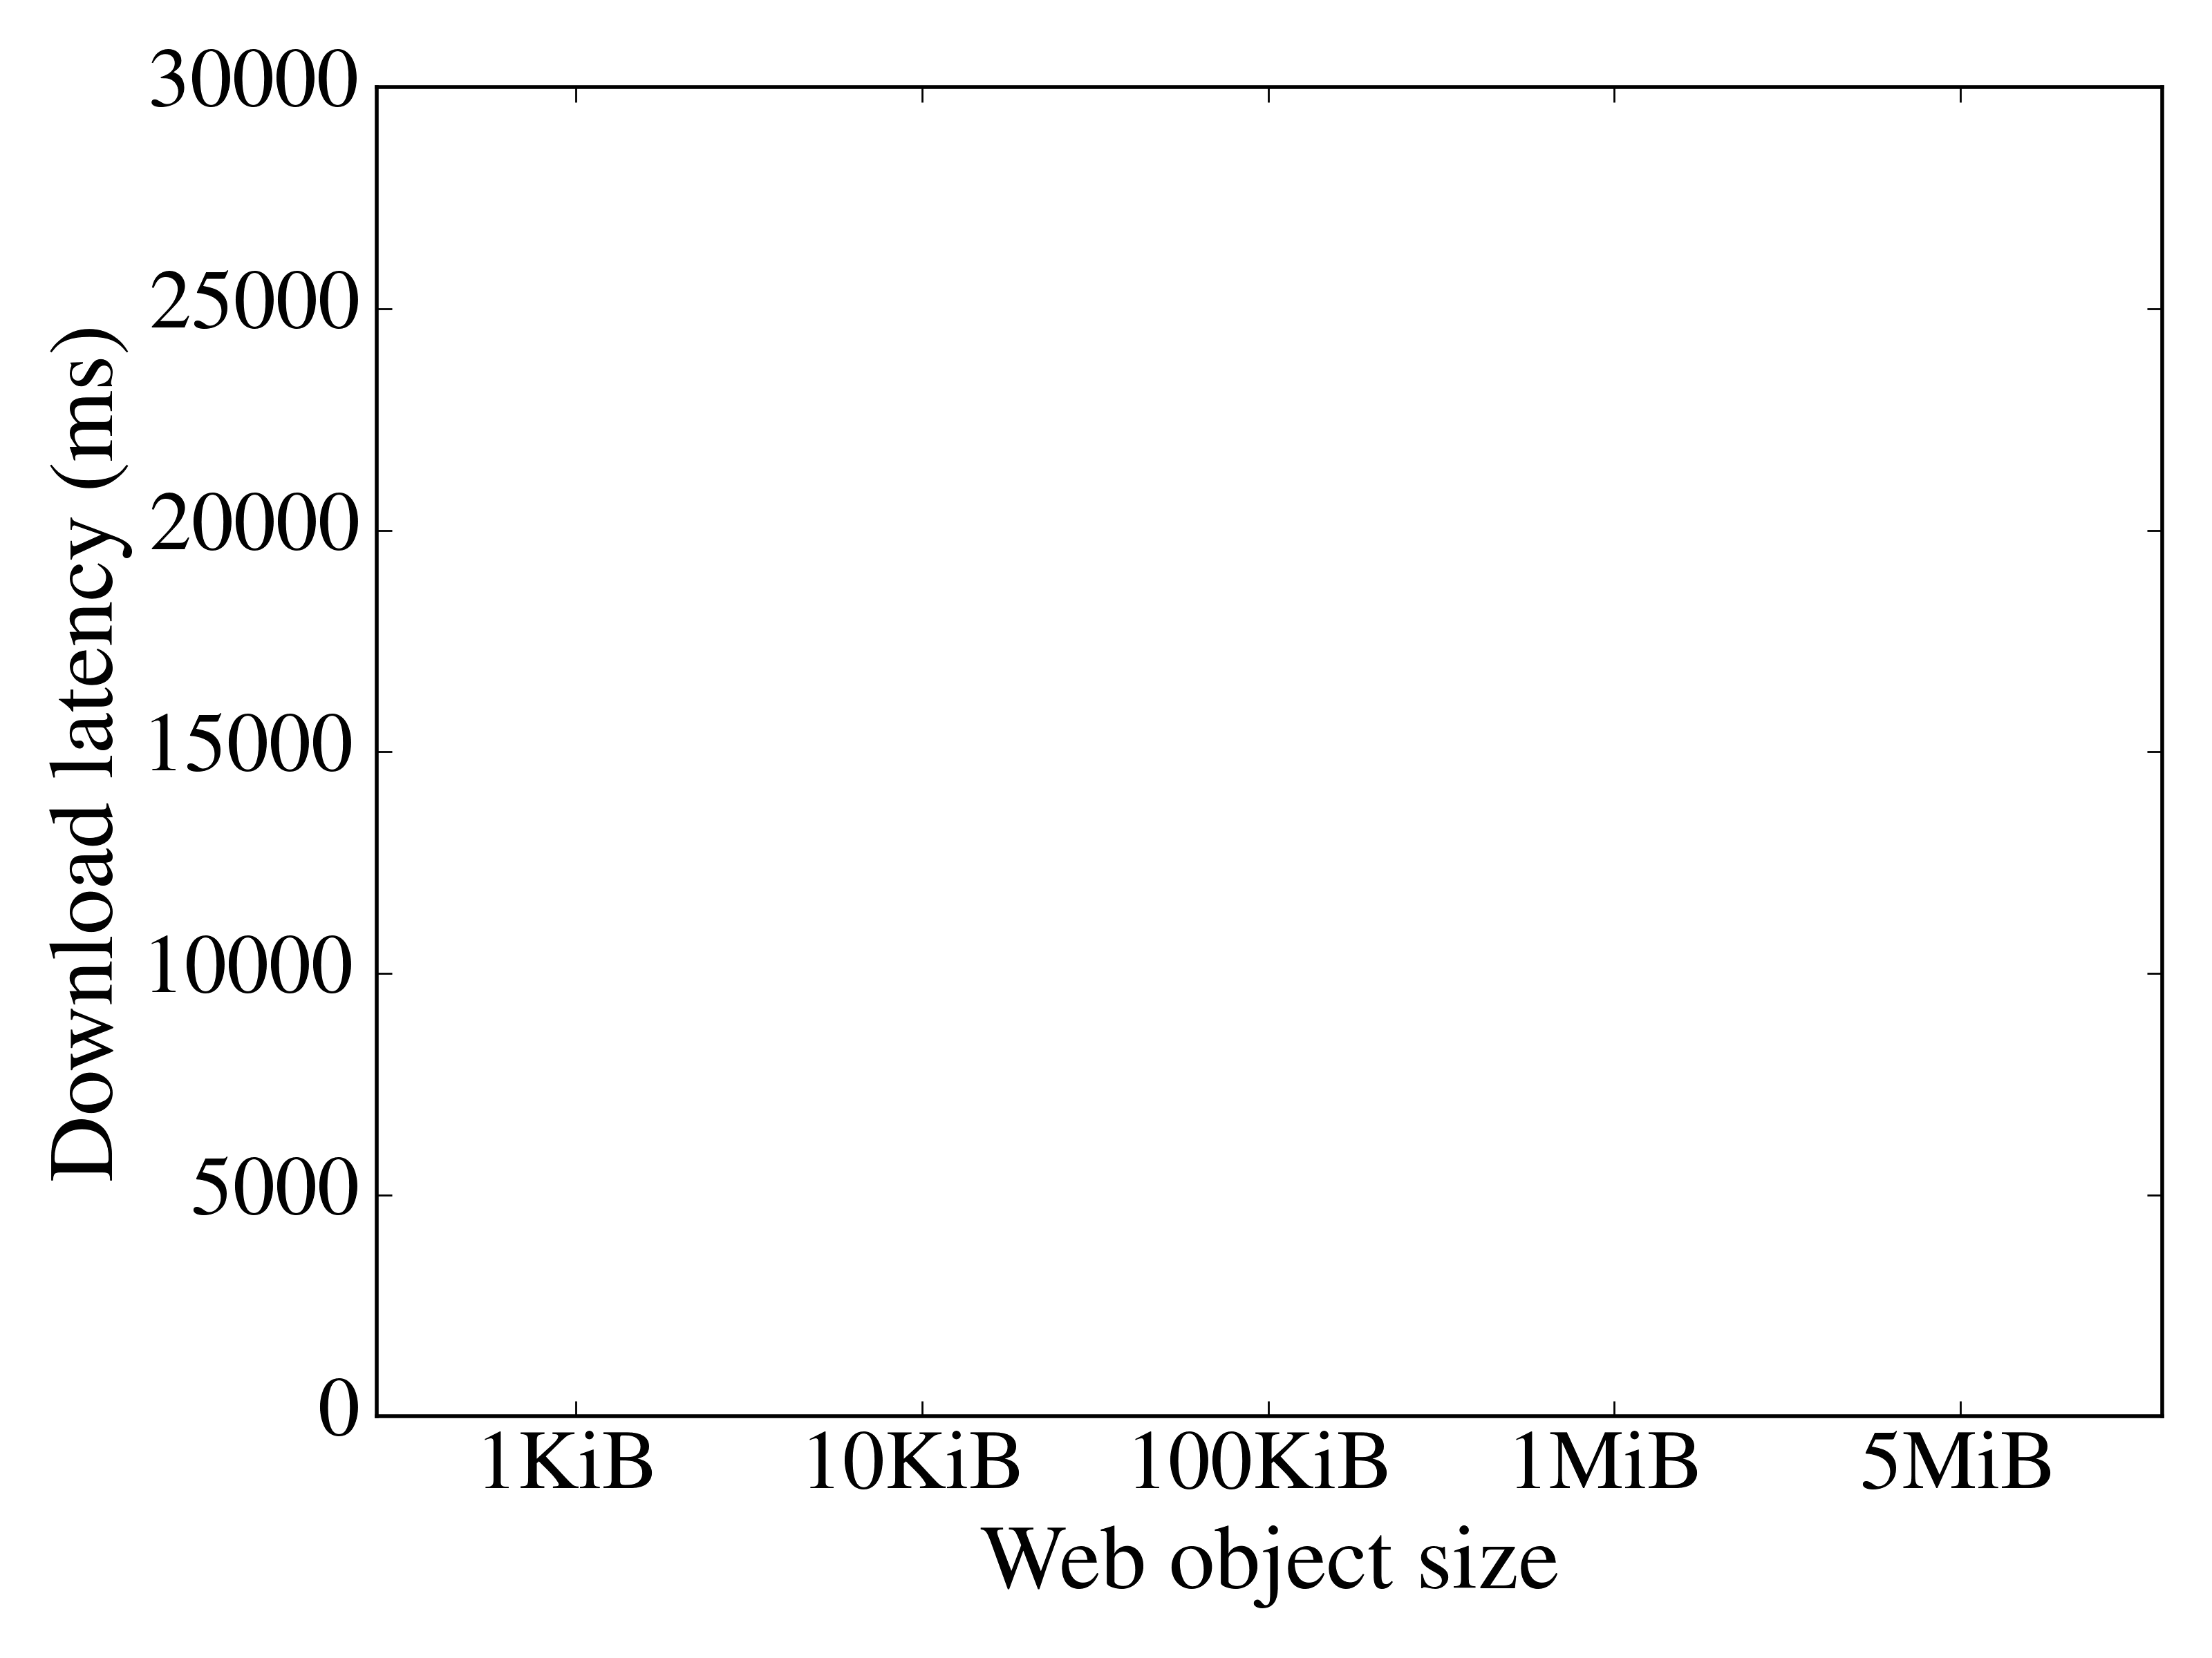
Latency

Slide 55
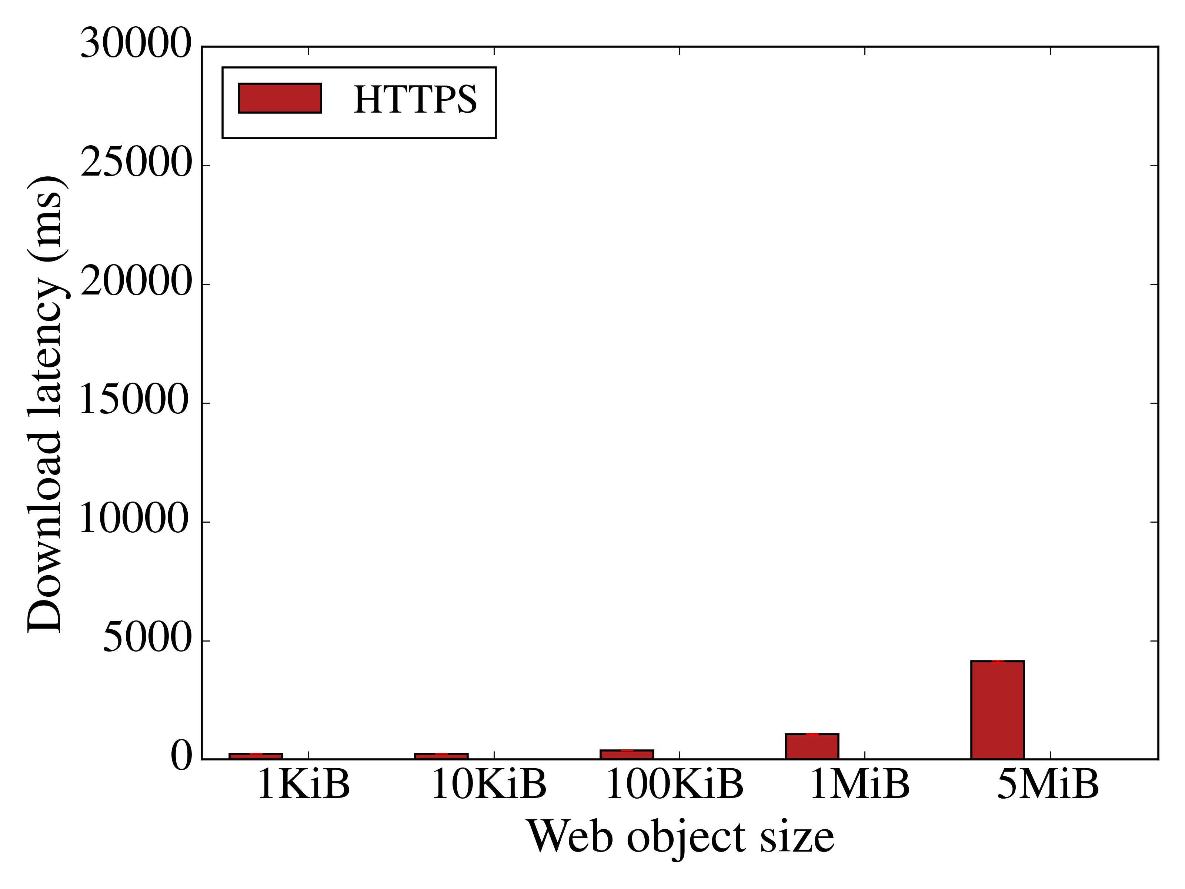
Latency

Slide 56
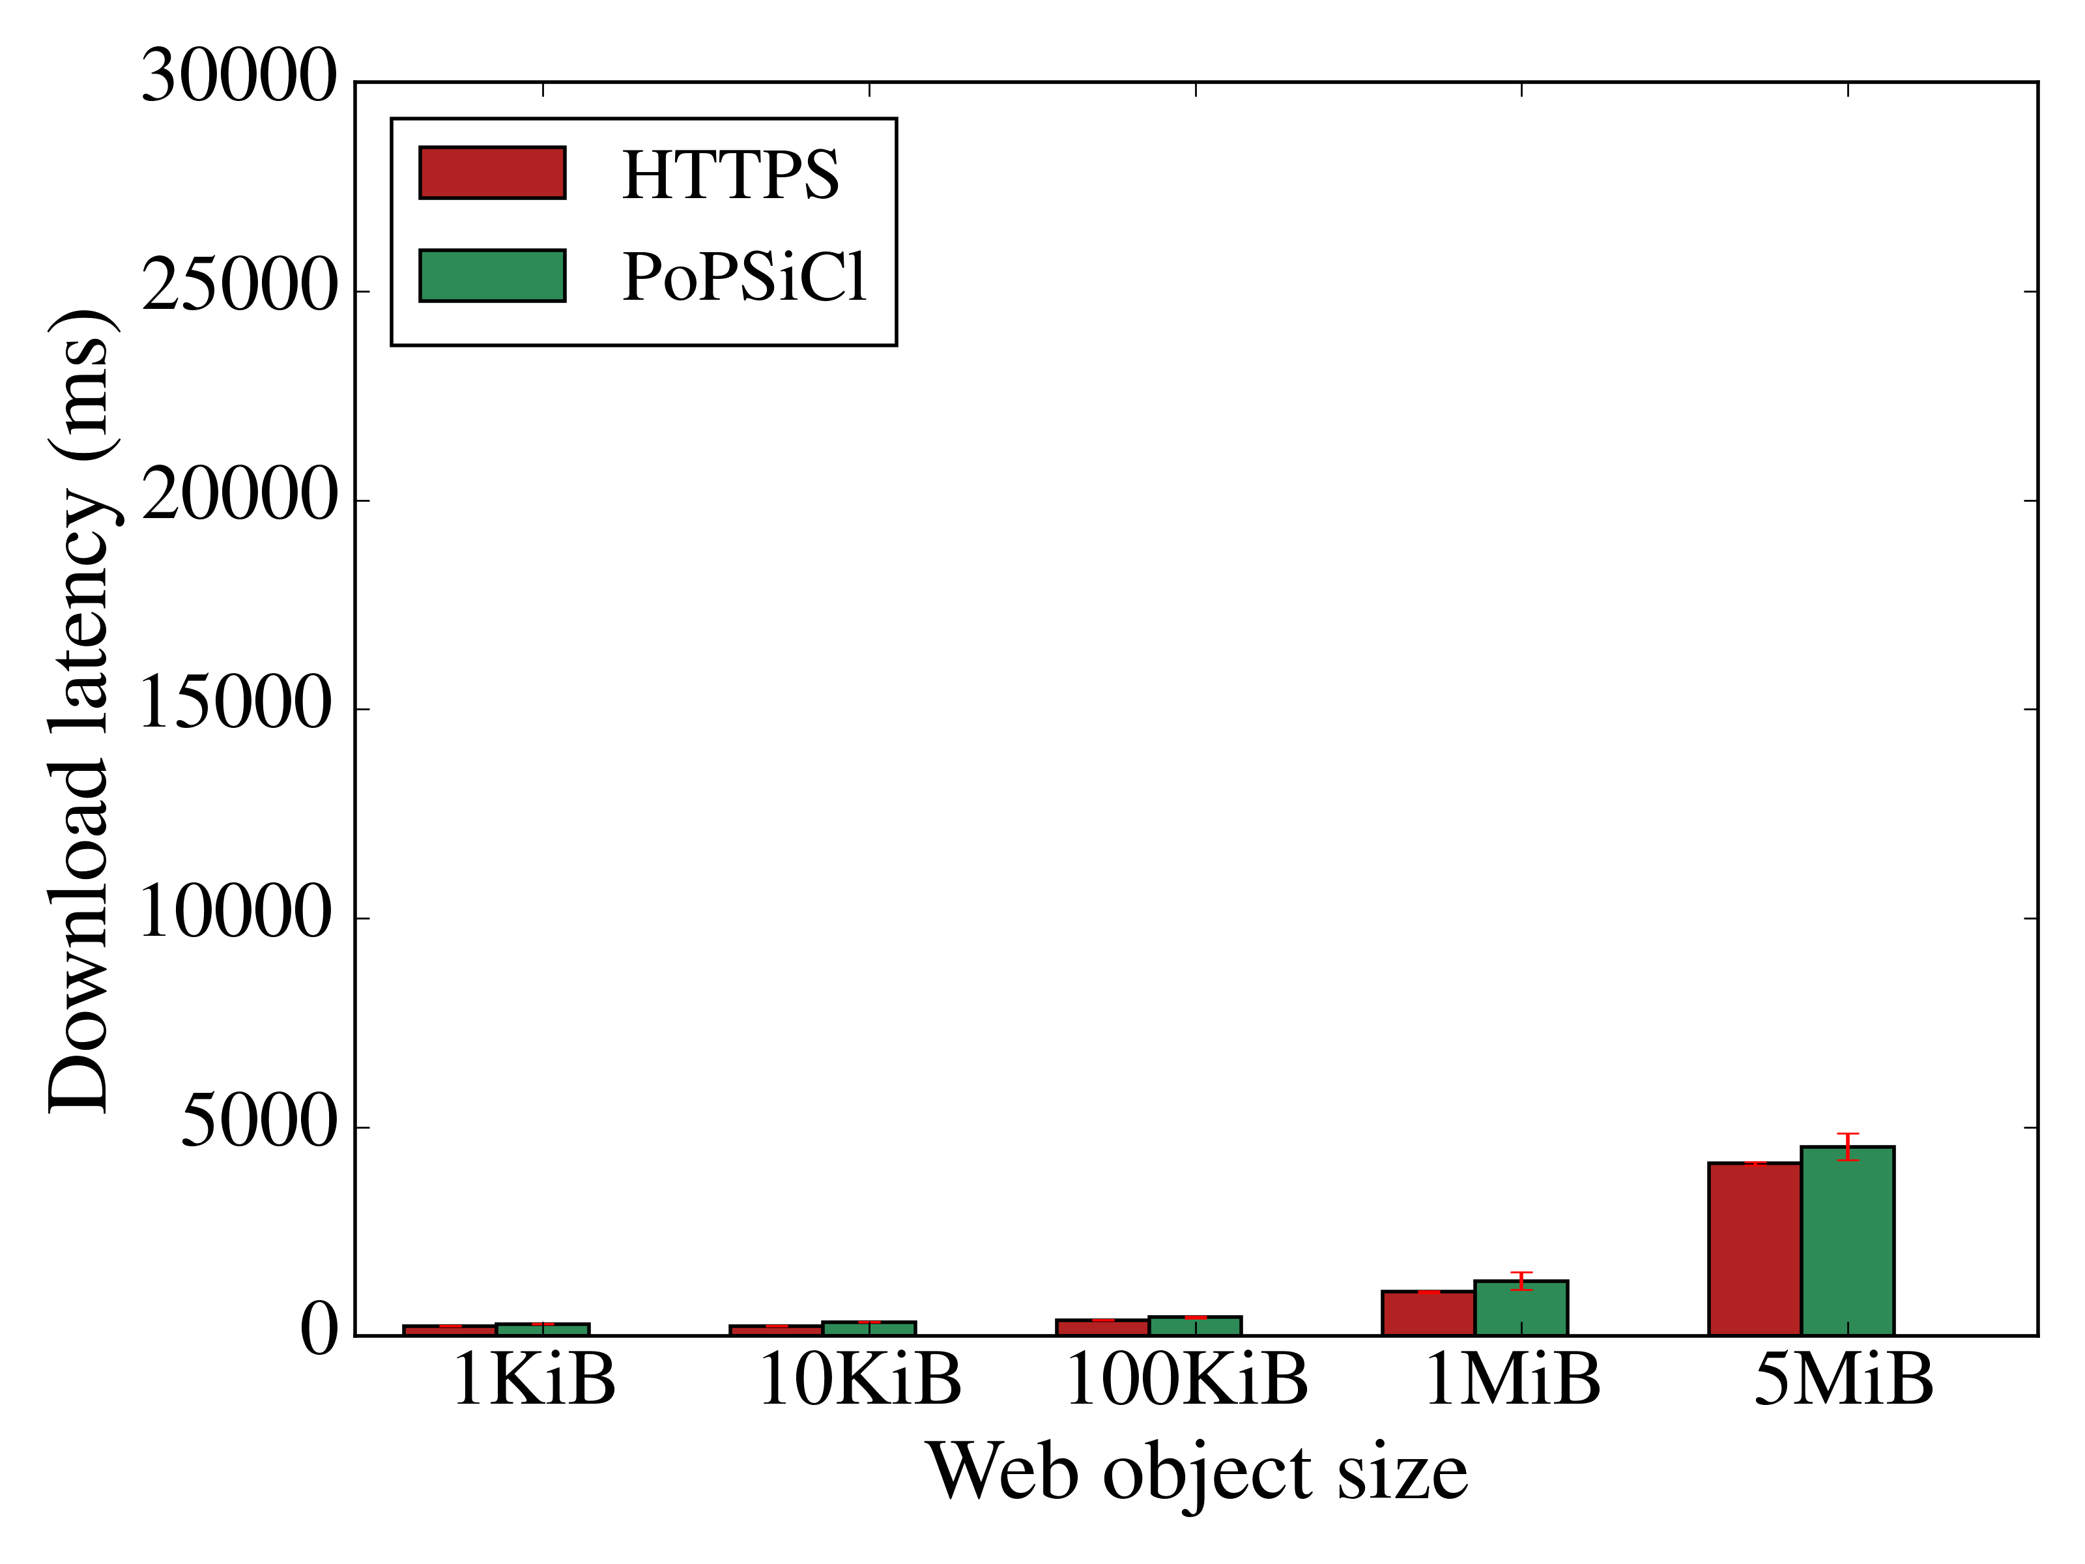
Latency

Slide 57
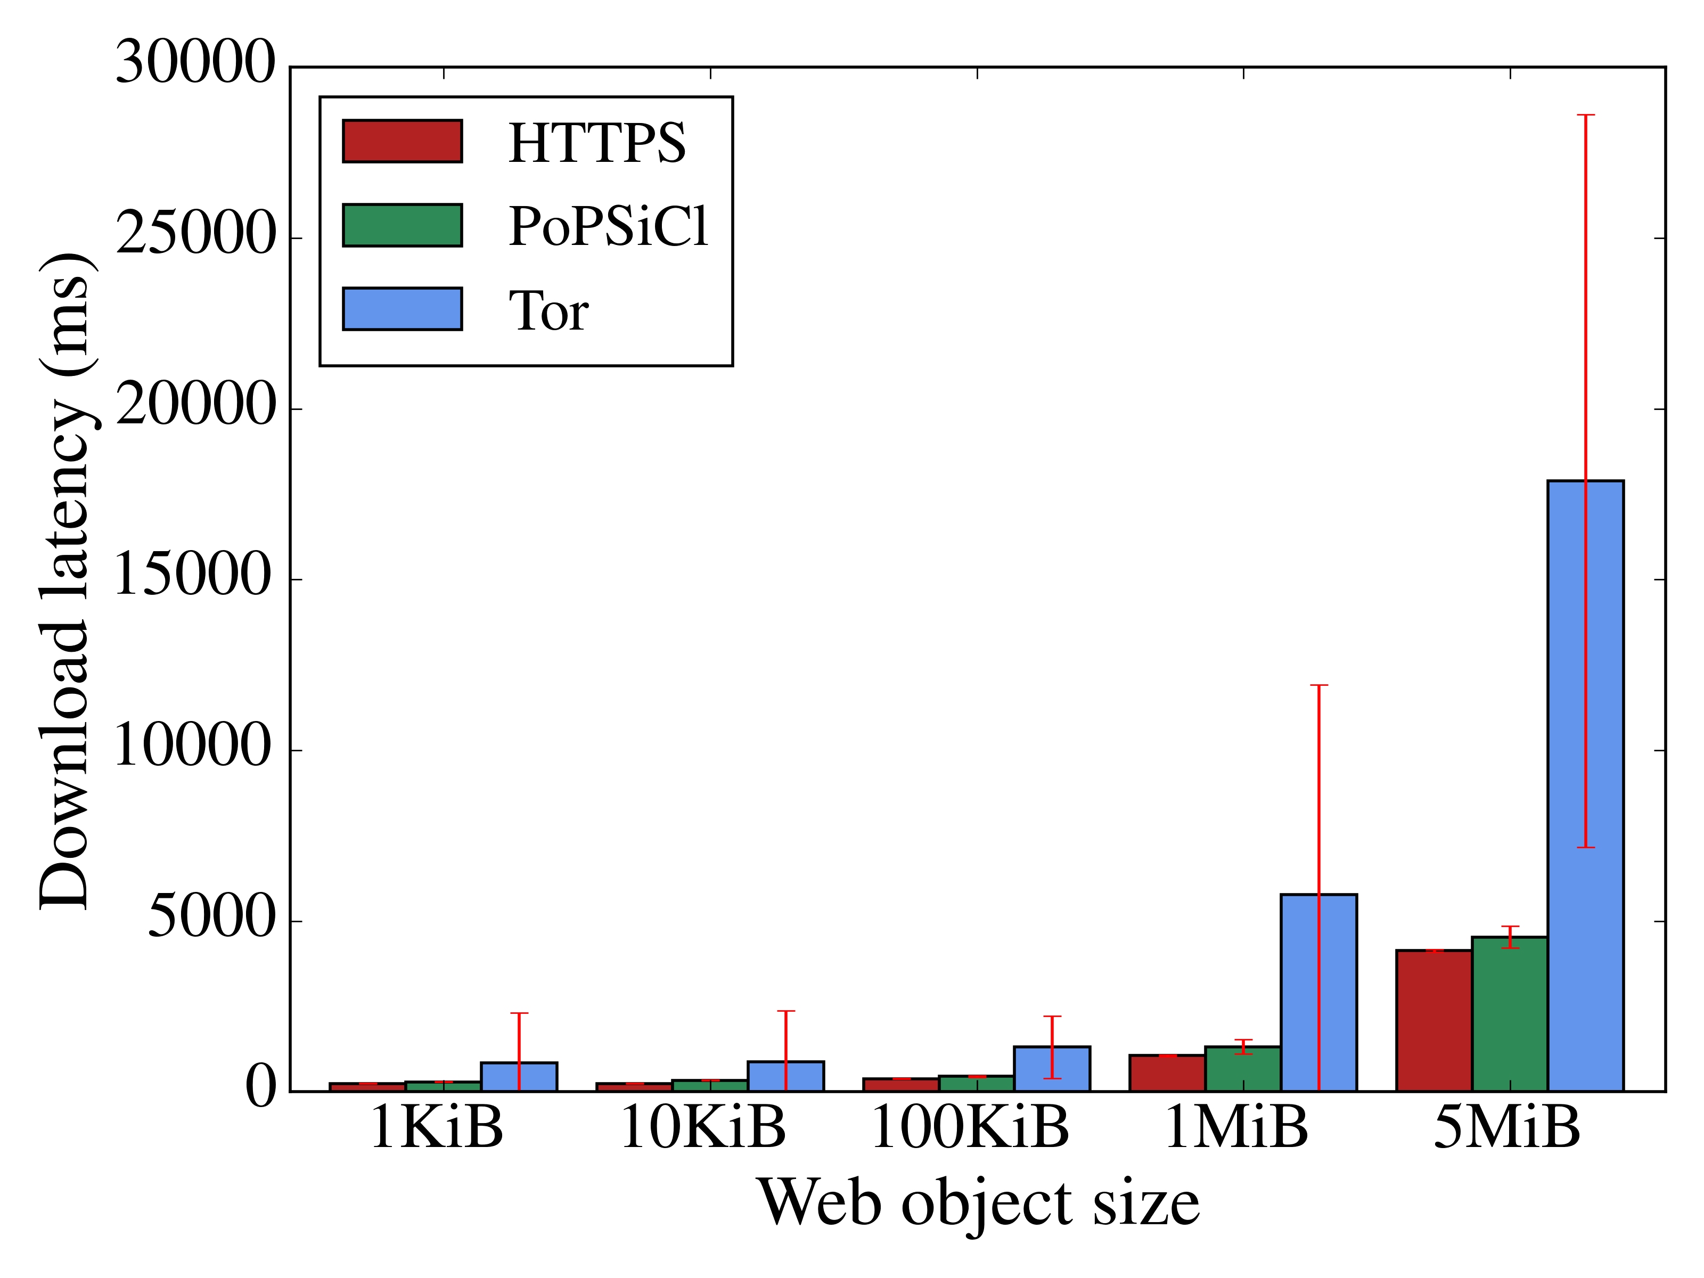
Latency

Slide 58
Latency
17.8s
4.5s
4.1s

Slide 59
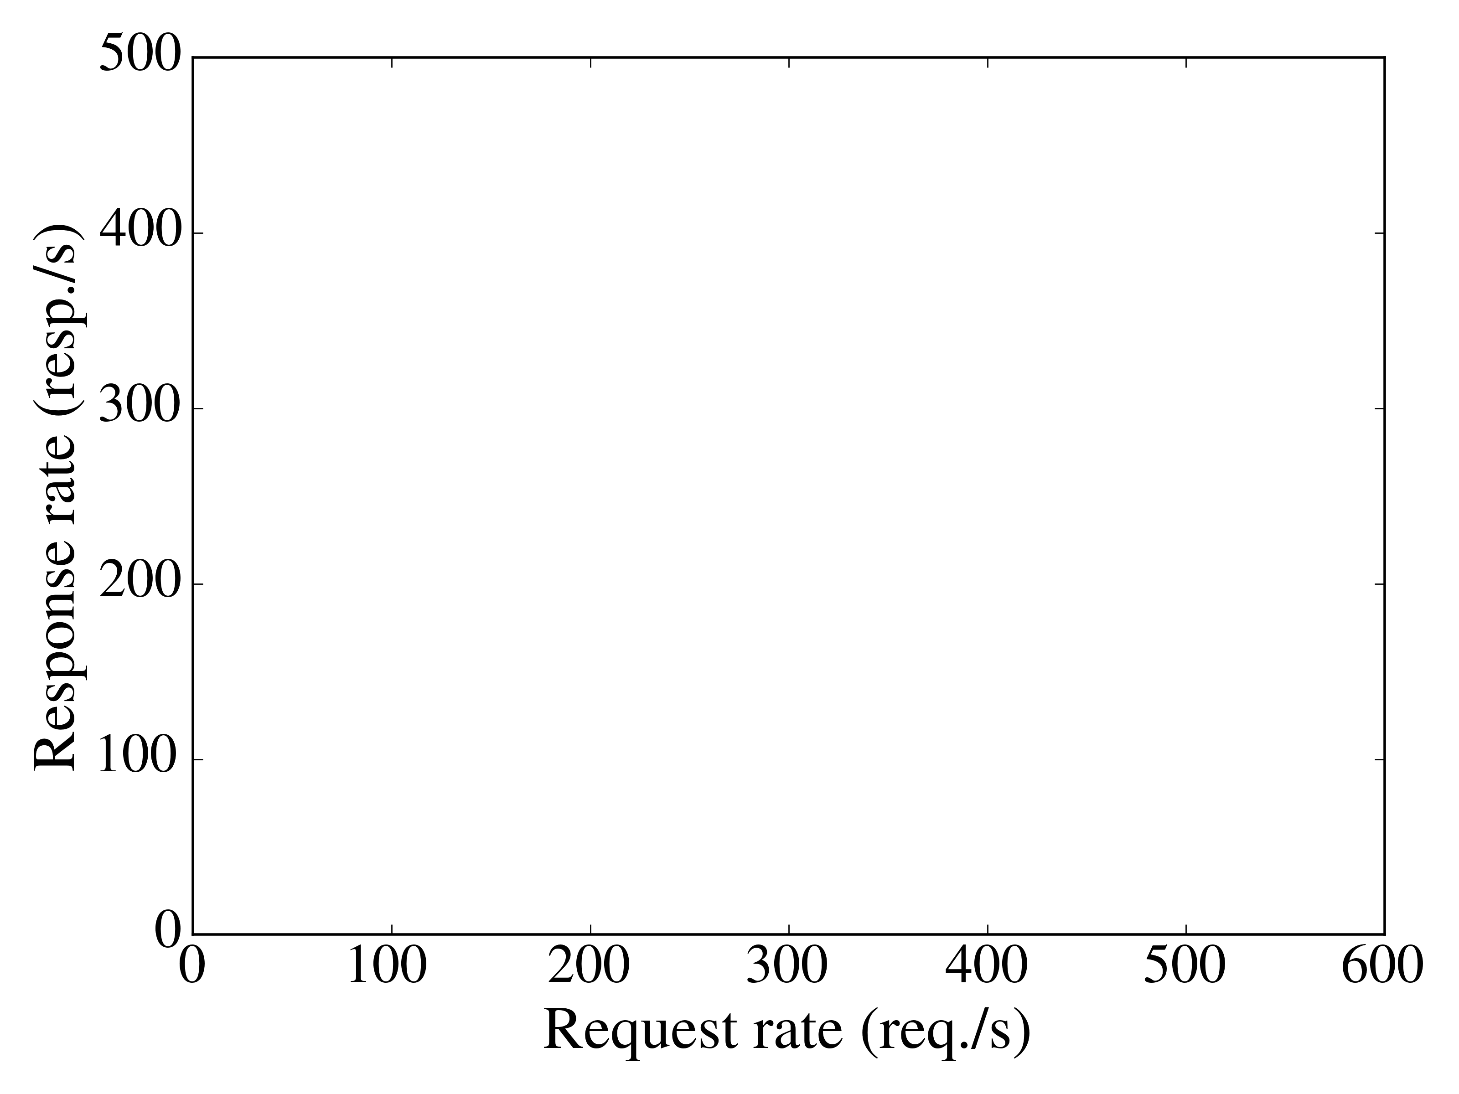
Throughput

Slide 60
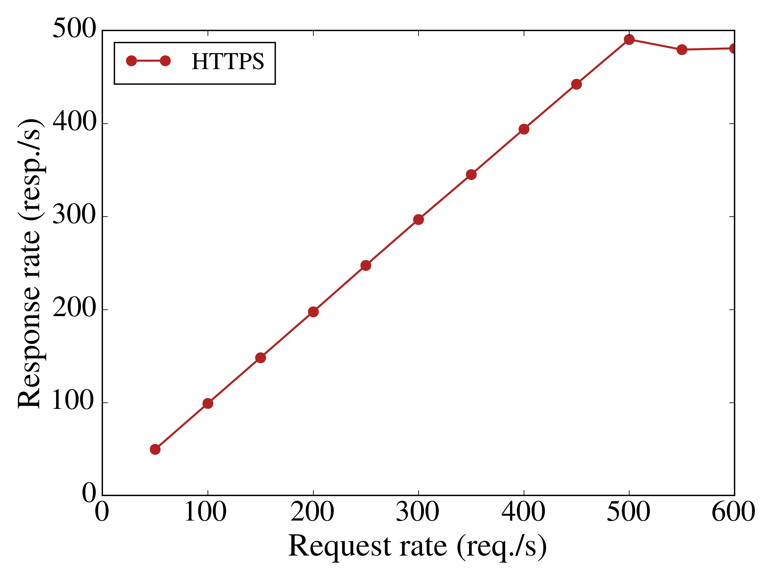
Throughput

Slide 61
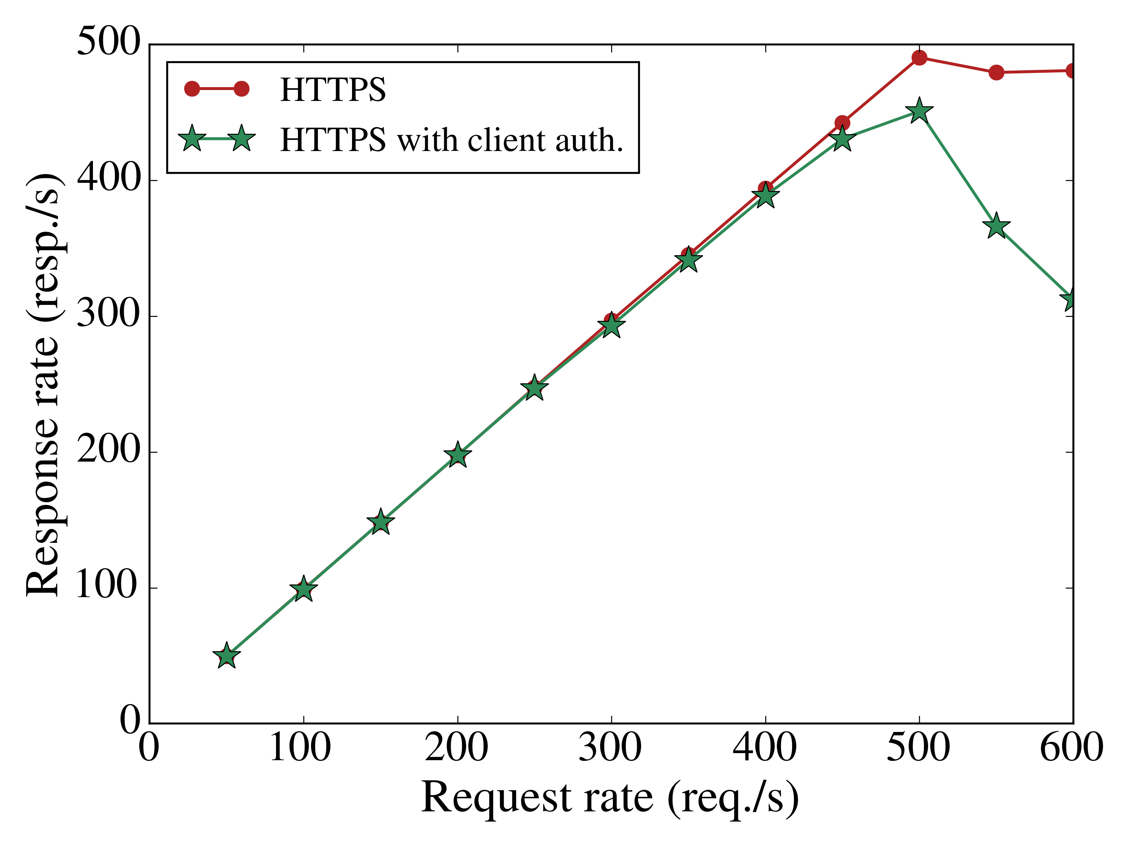
Throughput

Slide 62
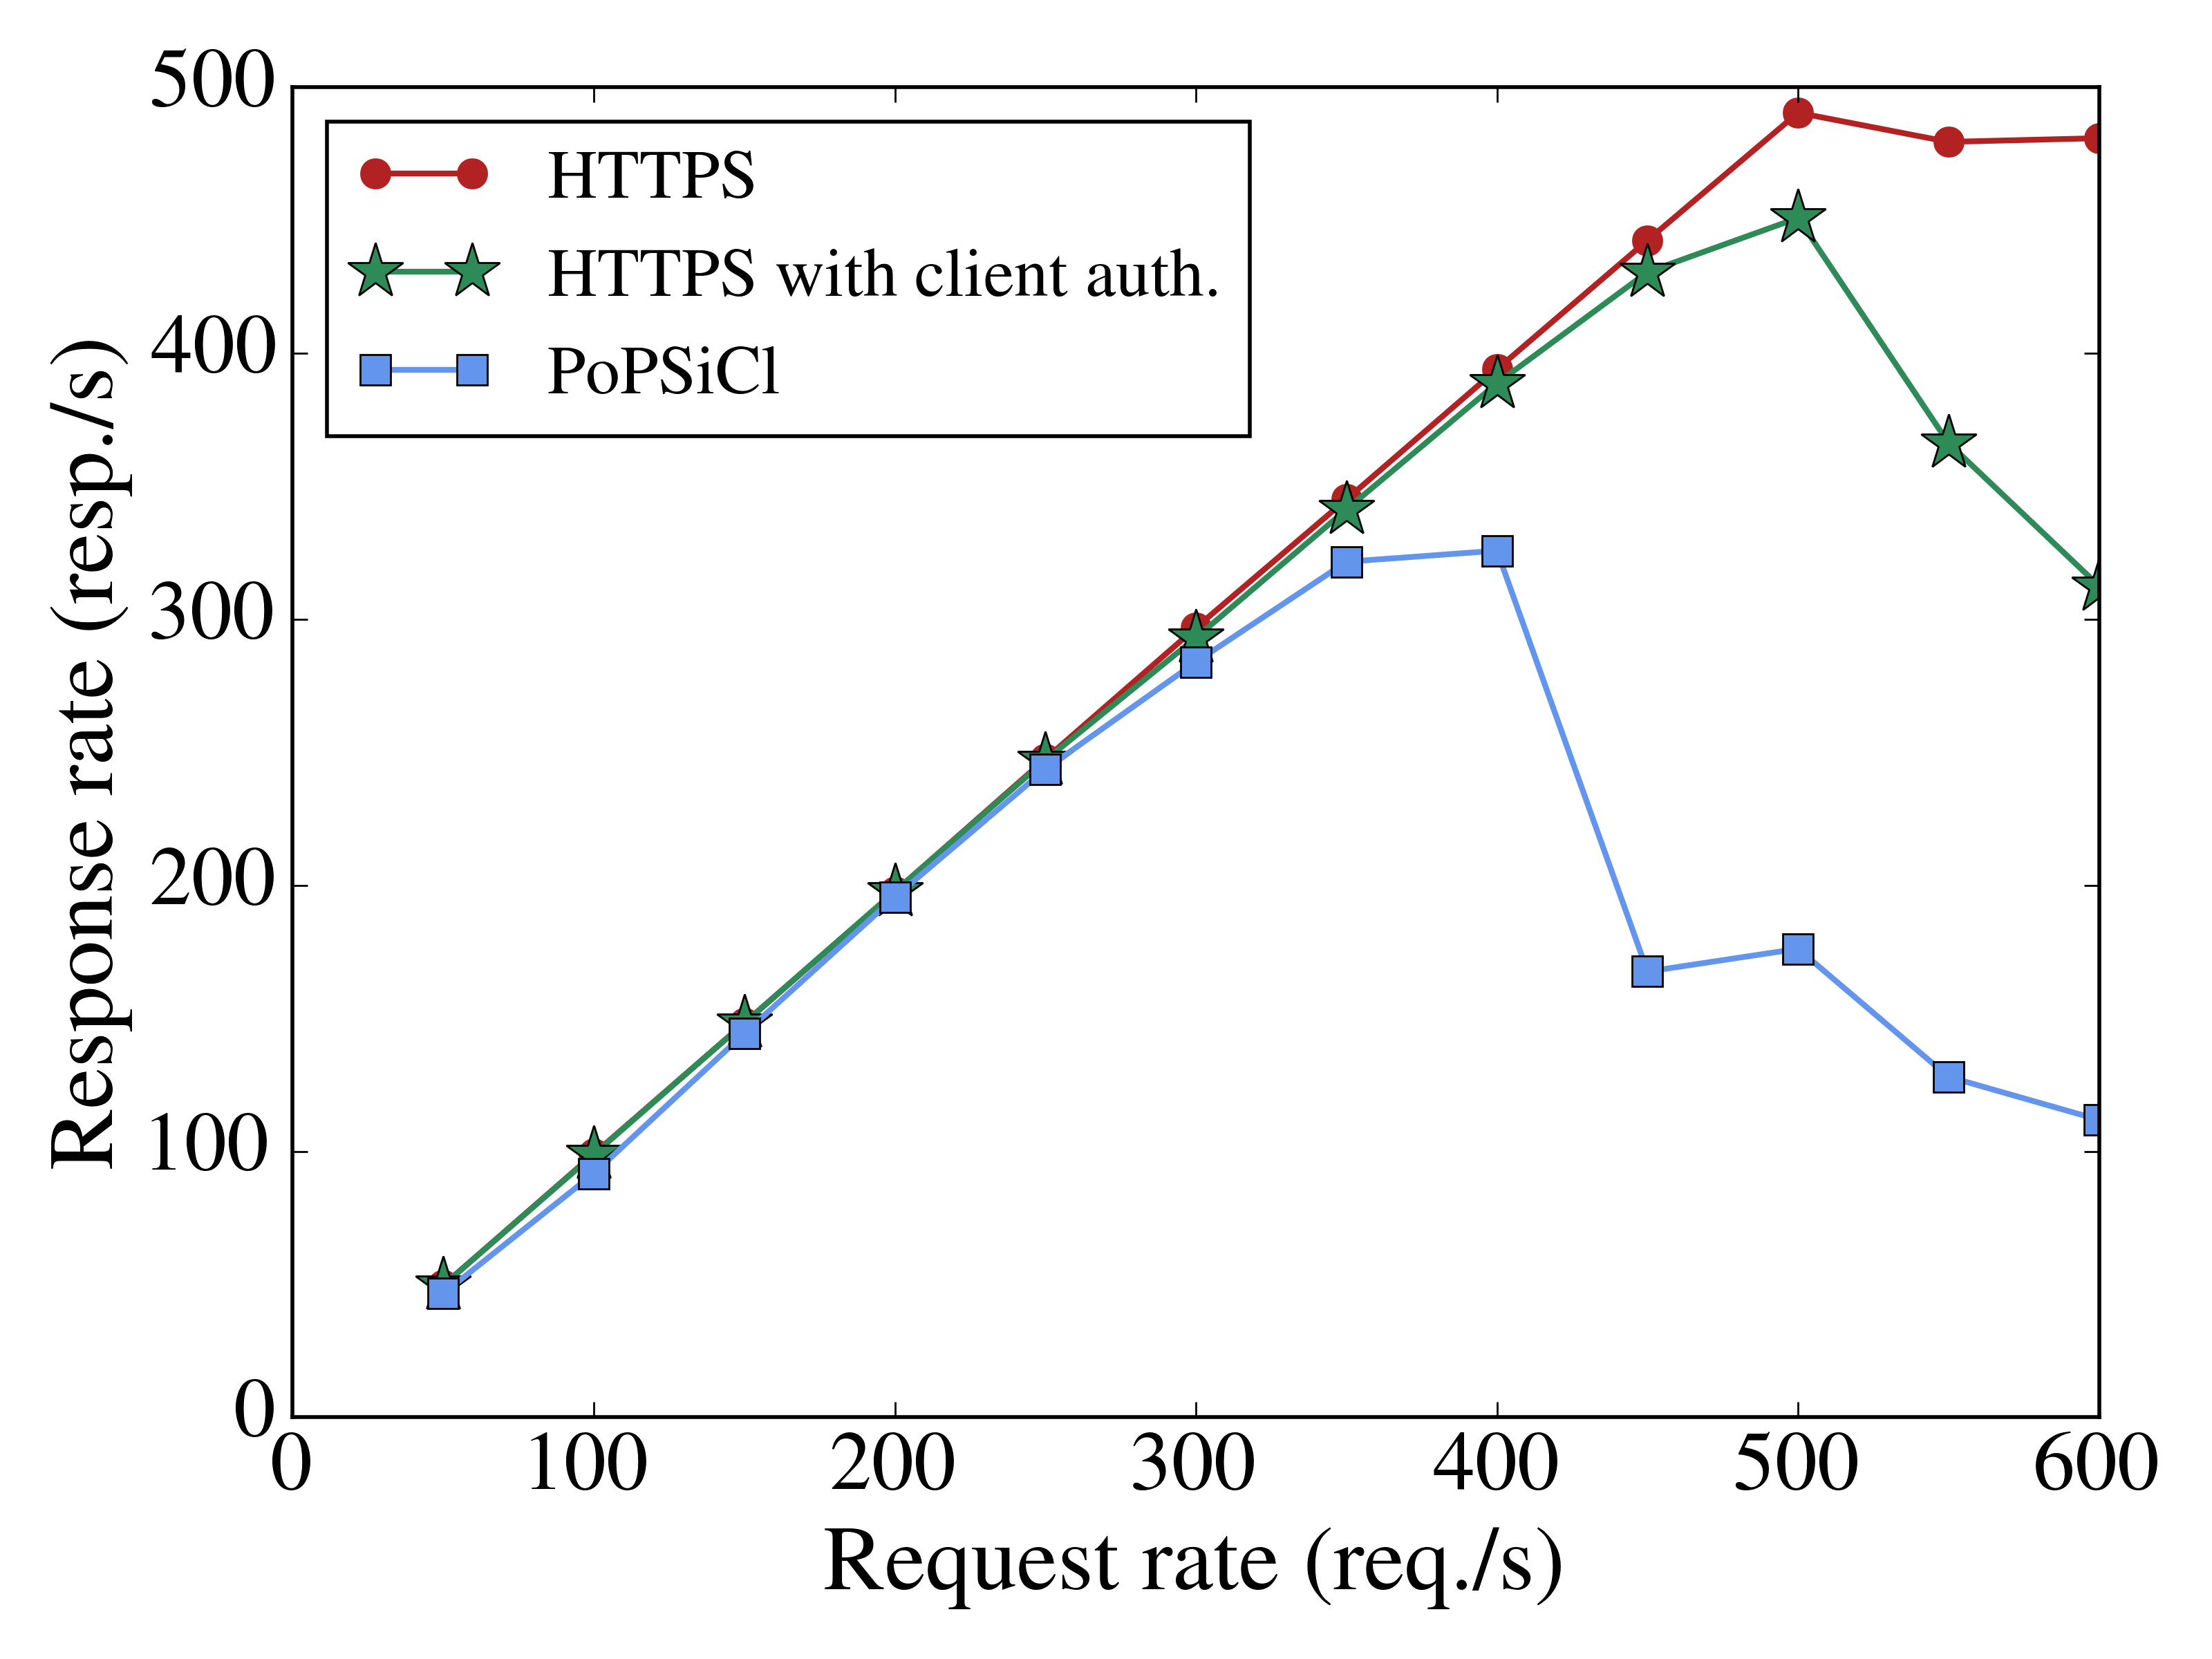
Throughput

Slide 63
Throughput
490.5
450.9
325.8

Slide 64
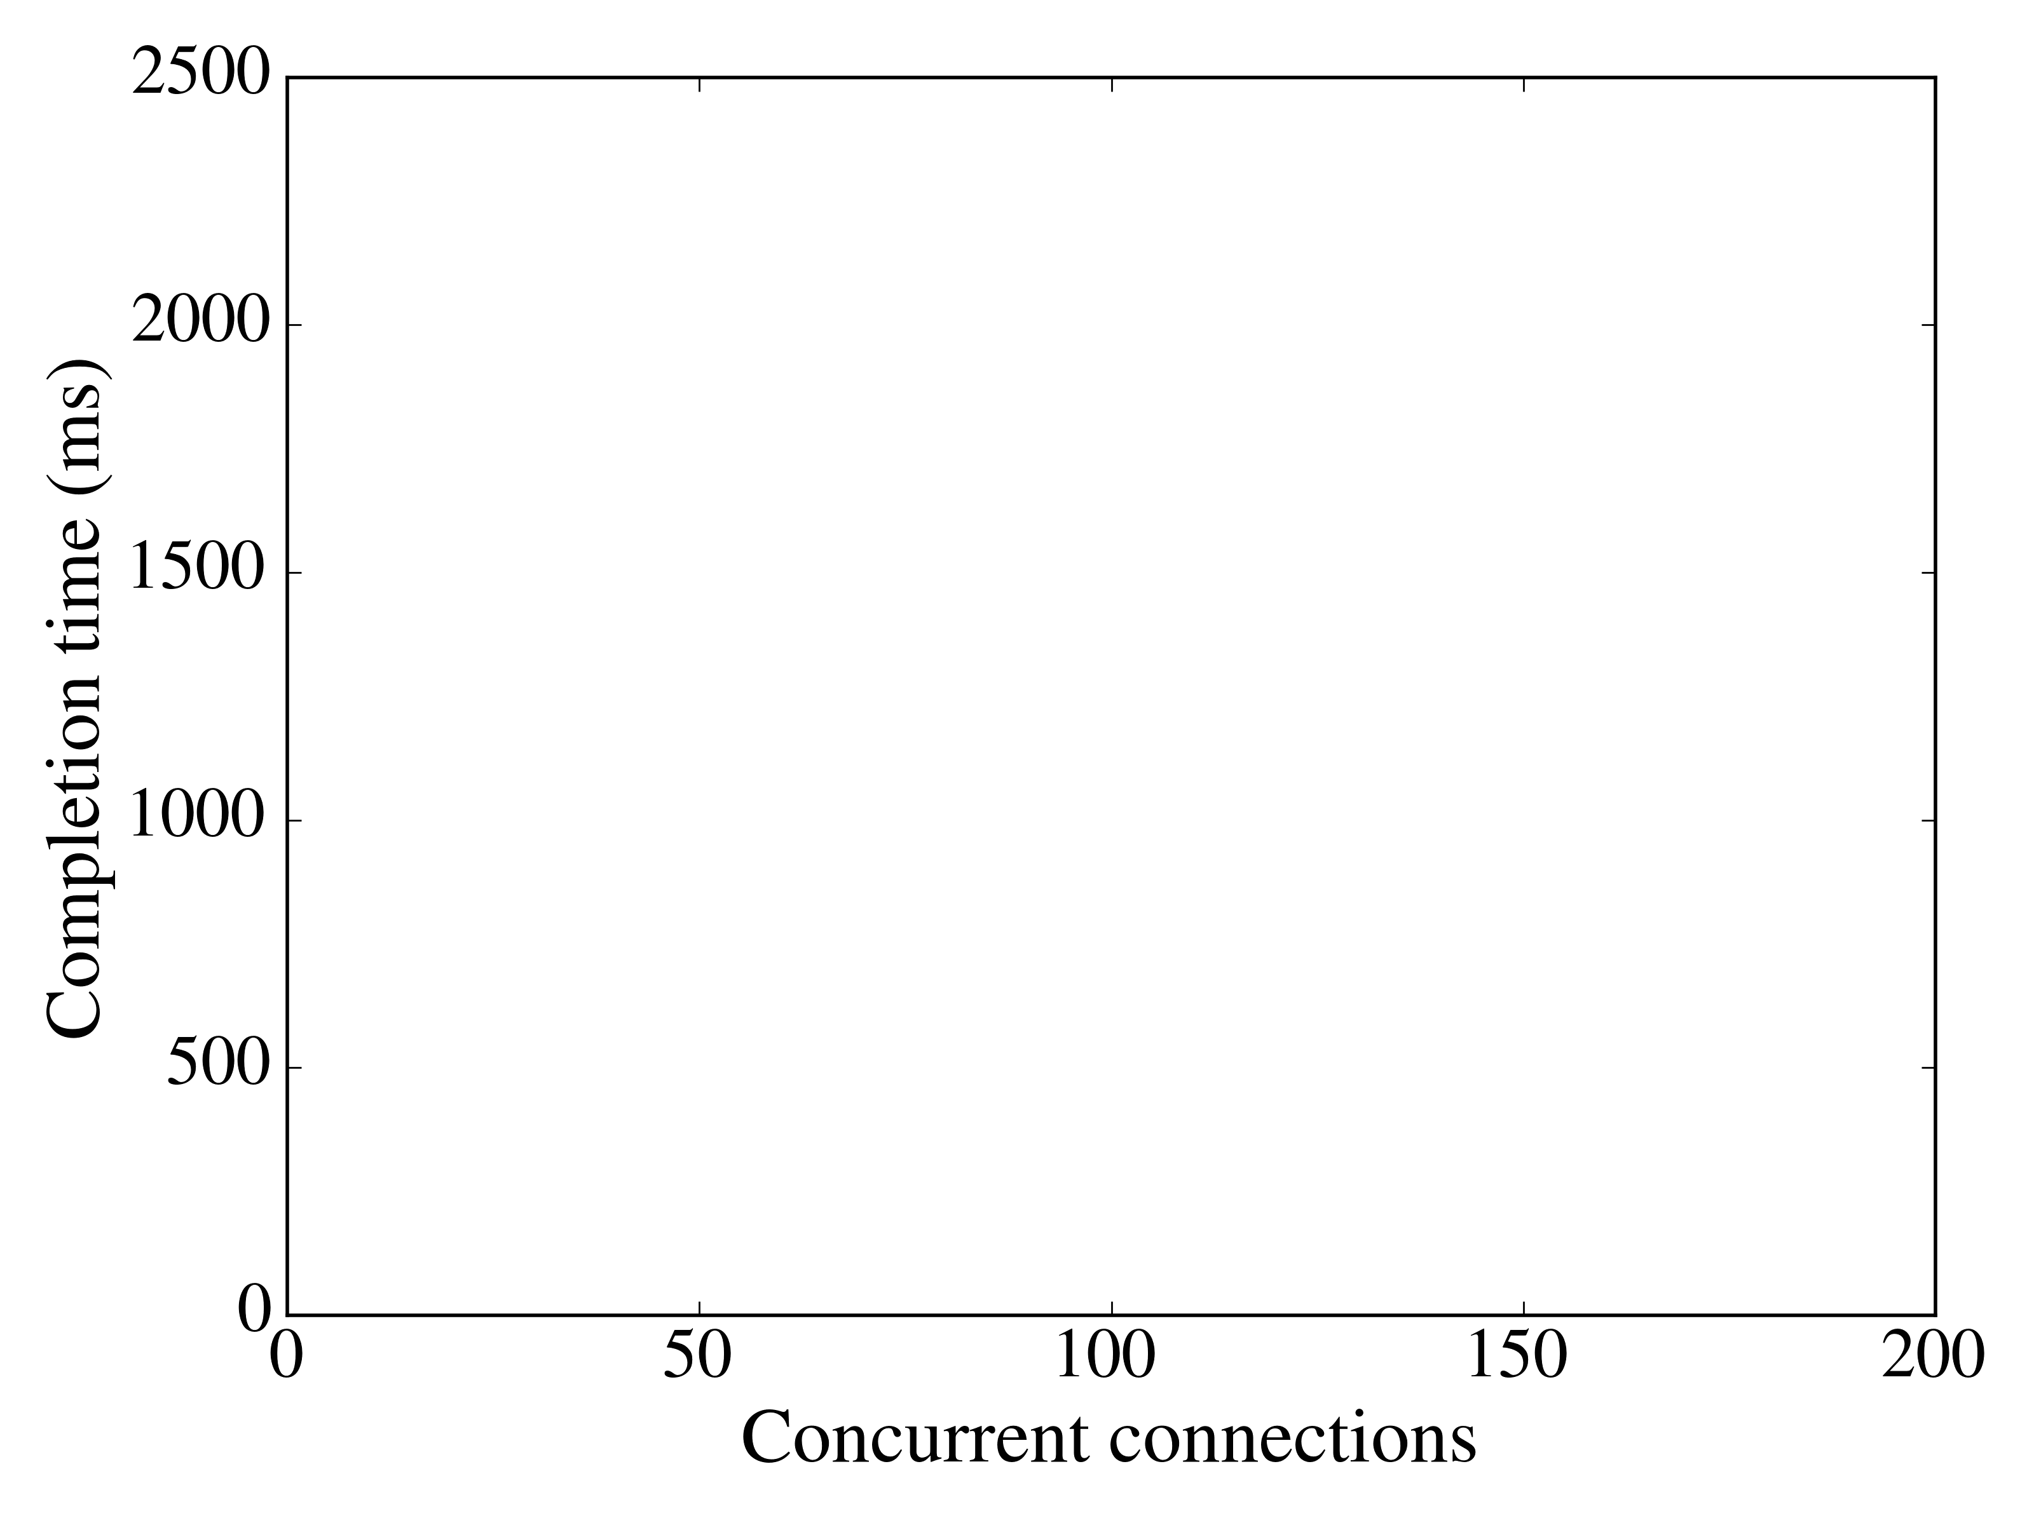
Scalability: Completion time per concurrent connections

Slide 65
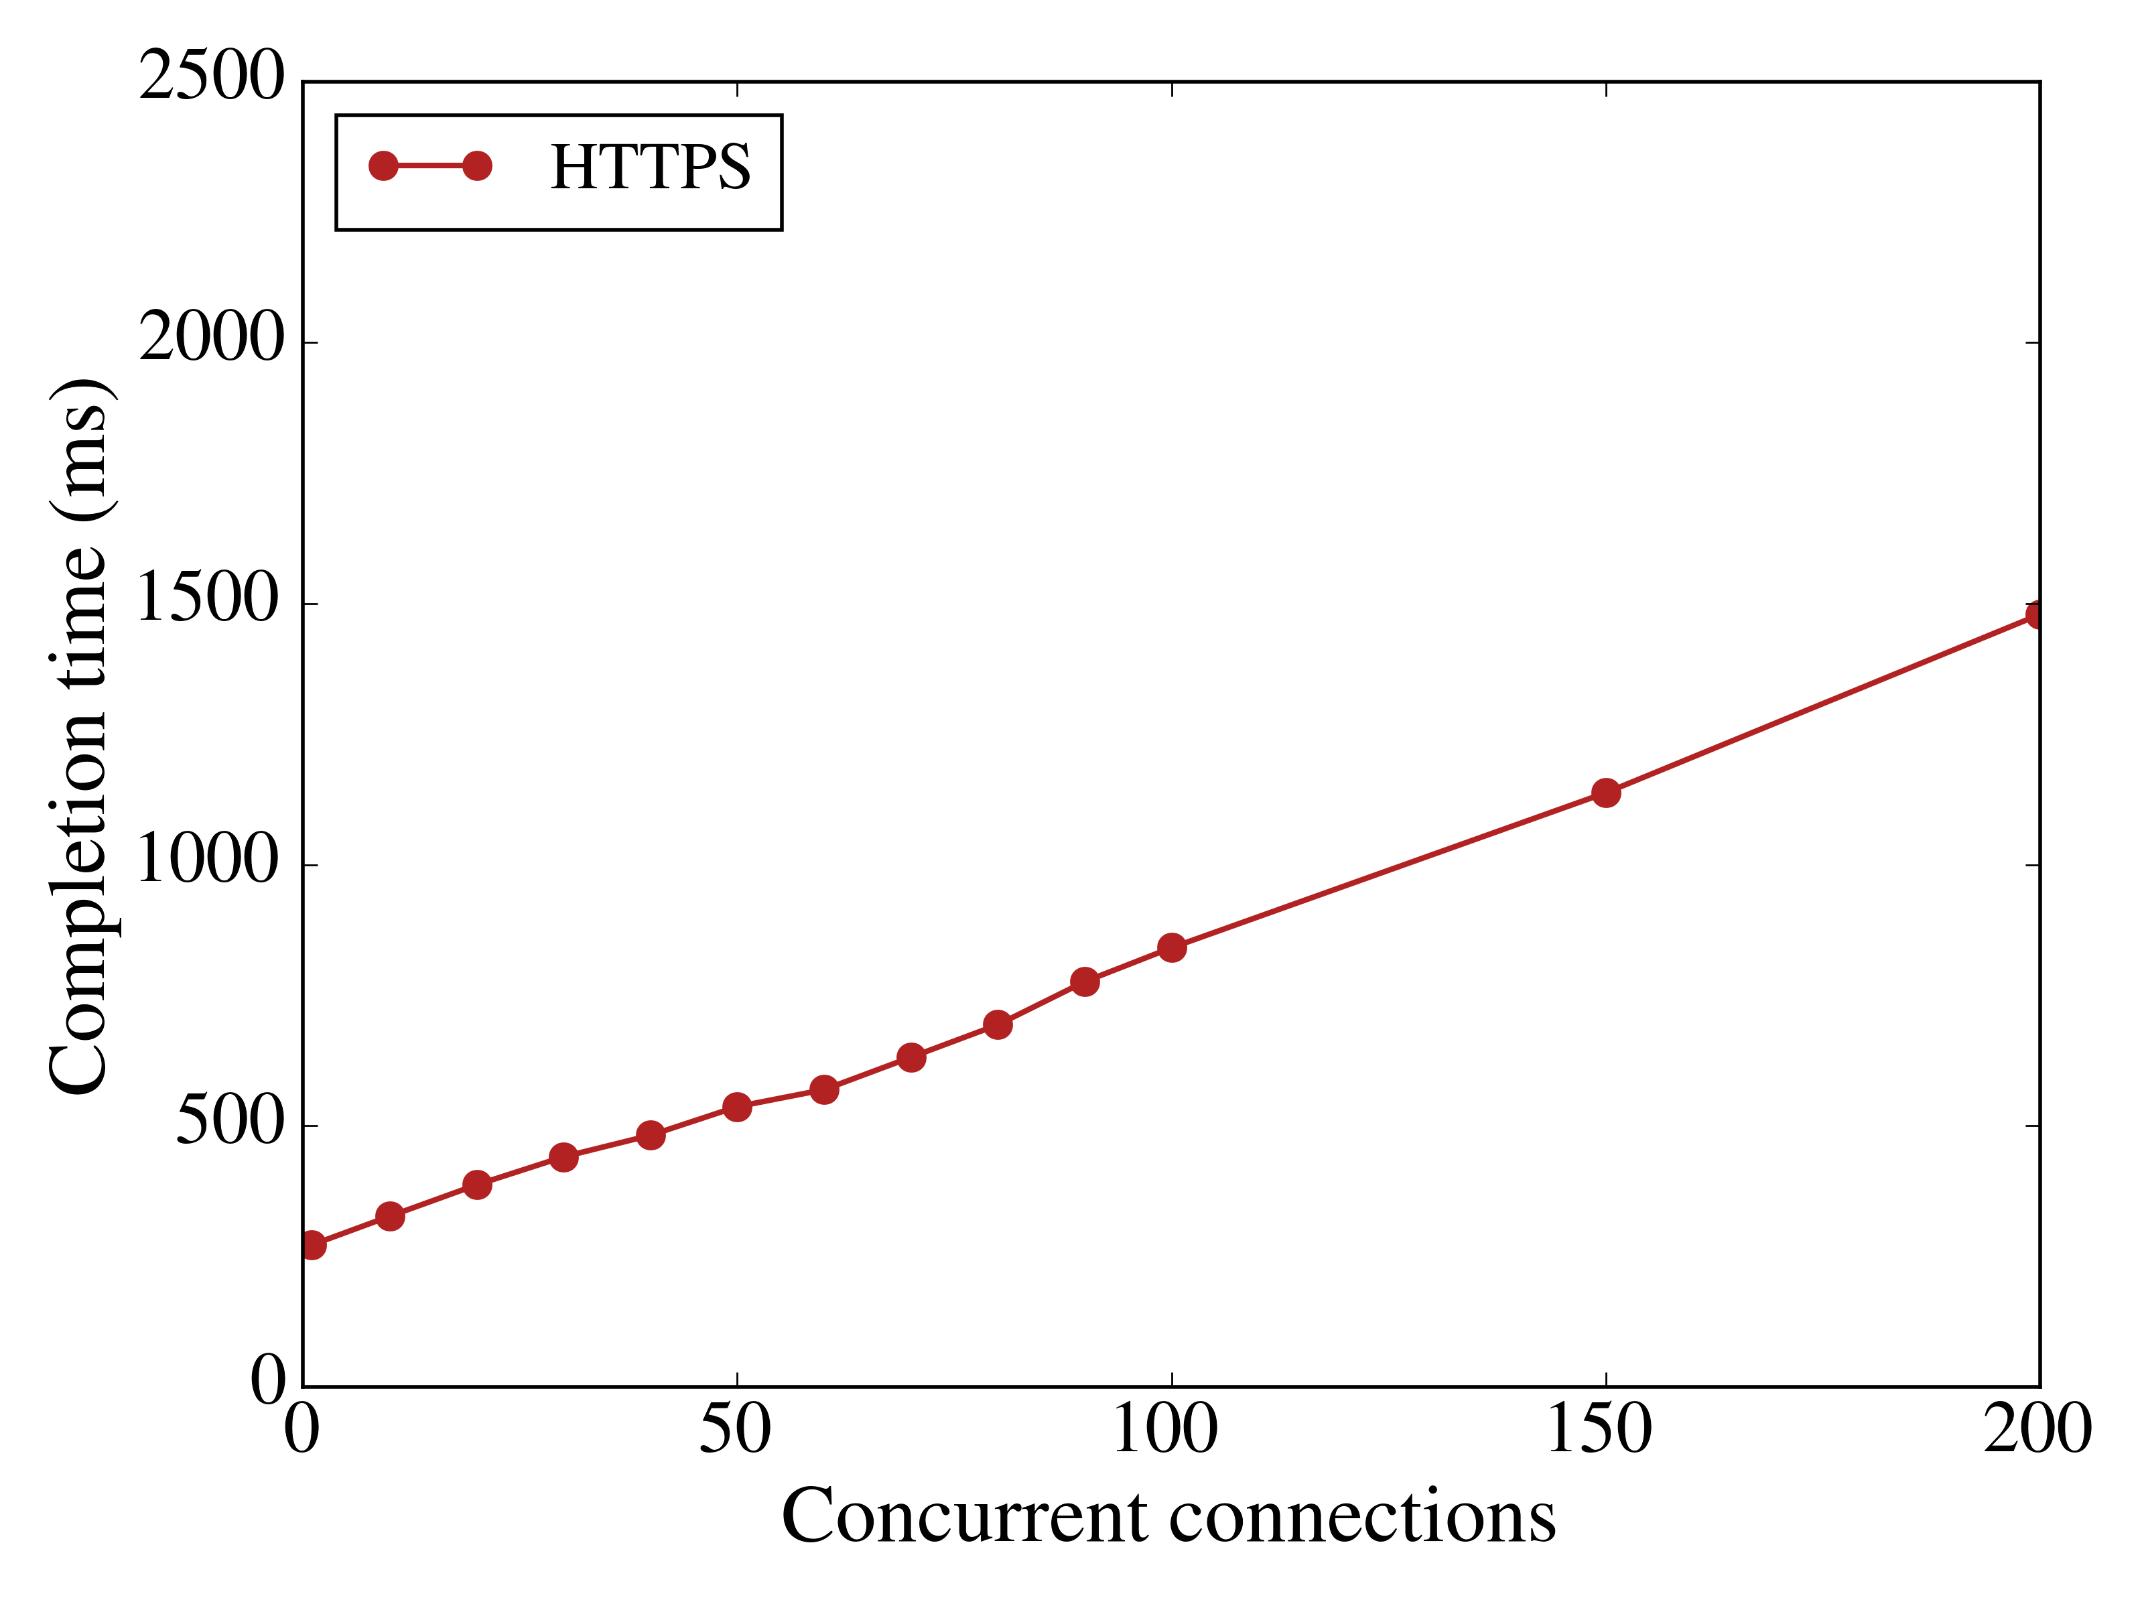
Scalability: Completion time per concurrent connections

Slide 66
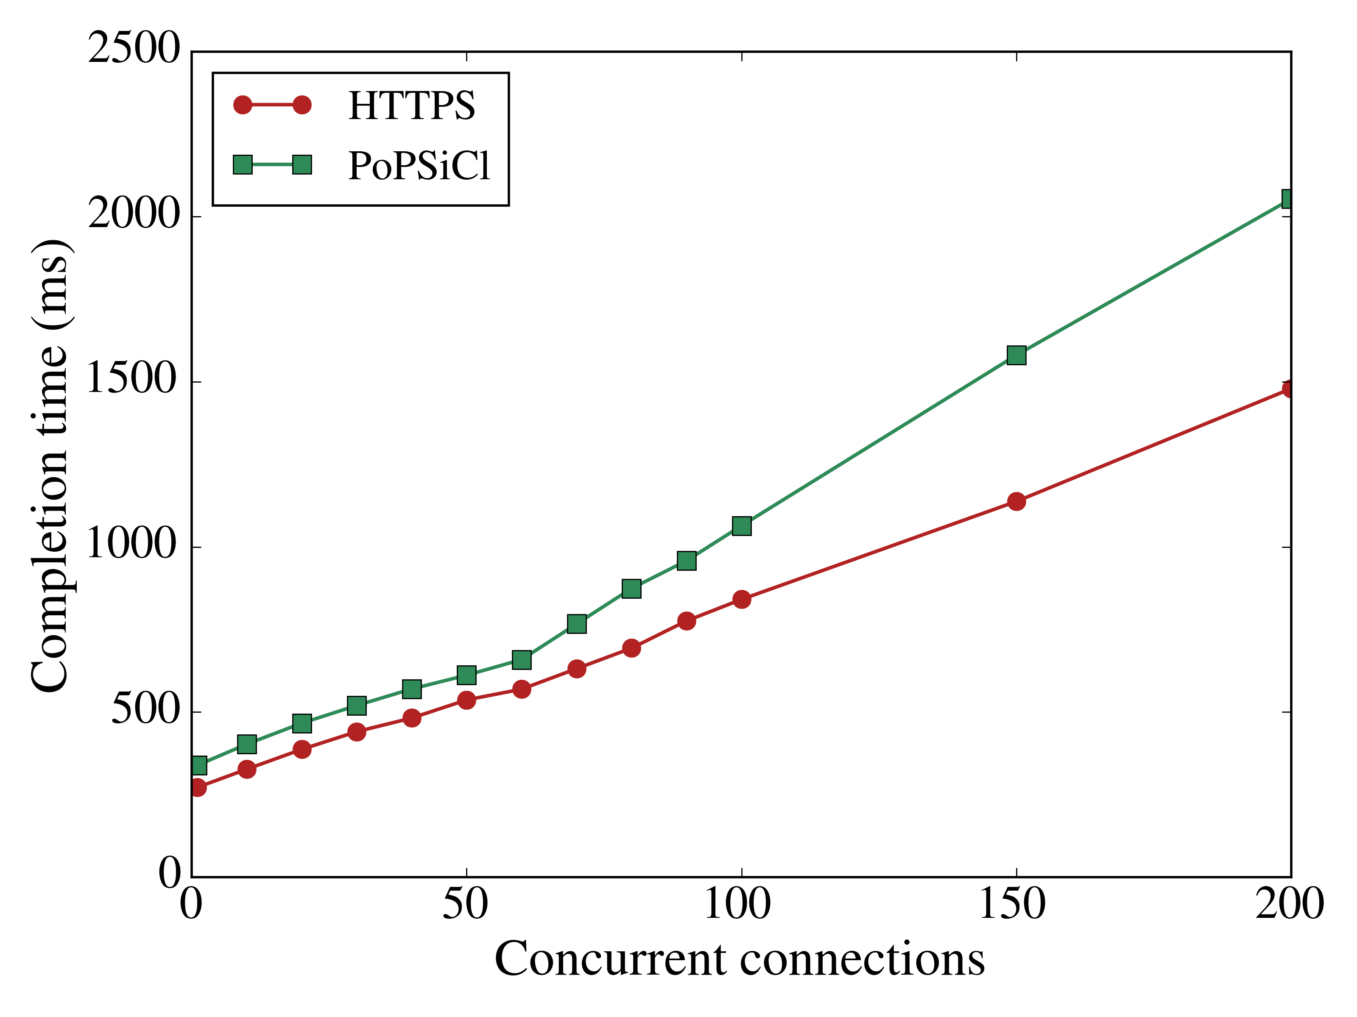
Scalability: Completion time per concurrent connections

Slide 67
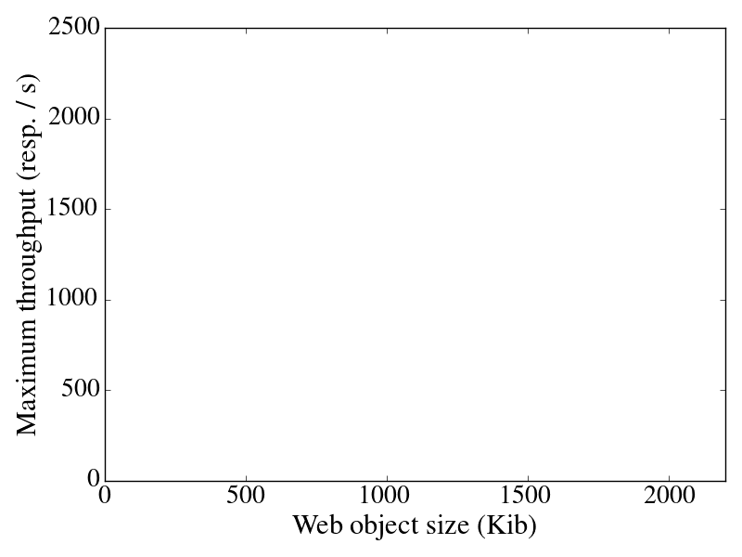
Scalability: Throughput per retrieved object size

Slide 68
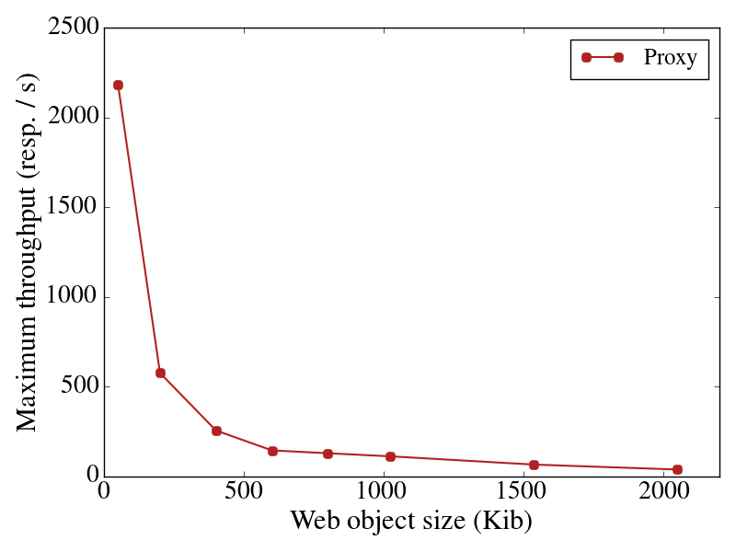
Scalability: Throughput per retrieved object size

Slide 69
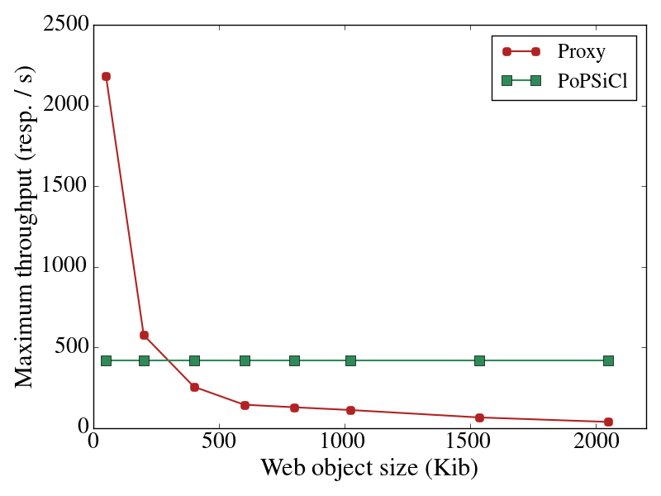
Scalability: Throughput per retrieved object size

Slide 70
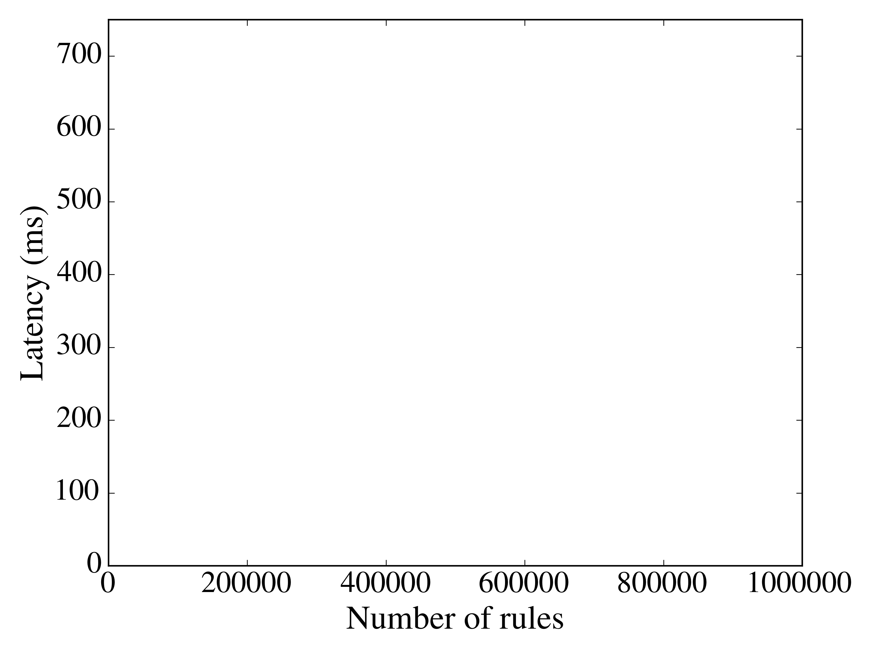
Scalability: Latency per # switch rules

Slide 71
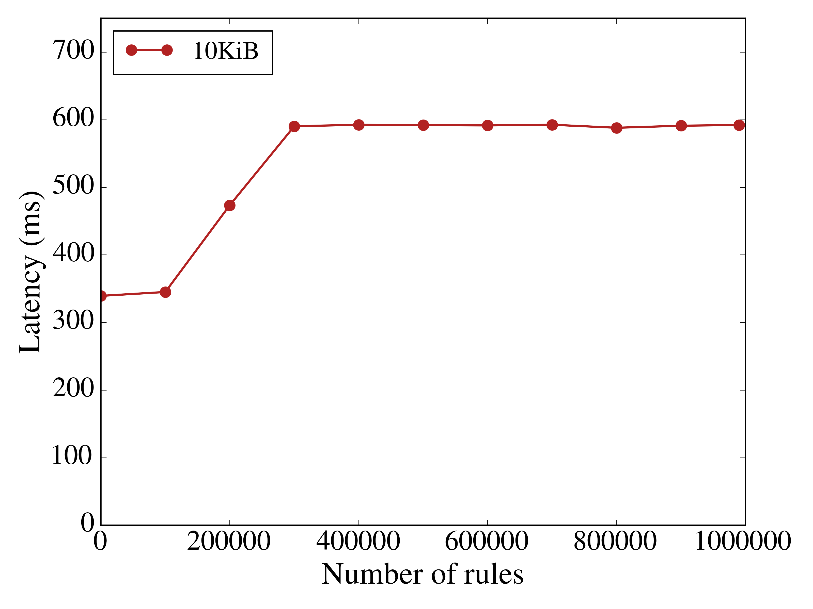
Scalability: Latency per # switch rules

Slide 72
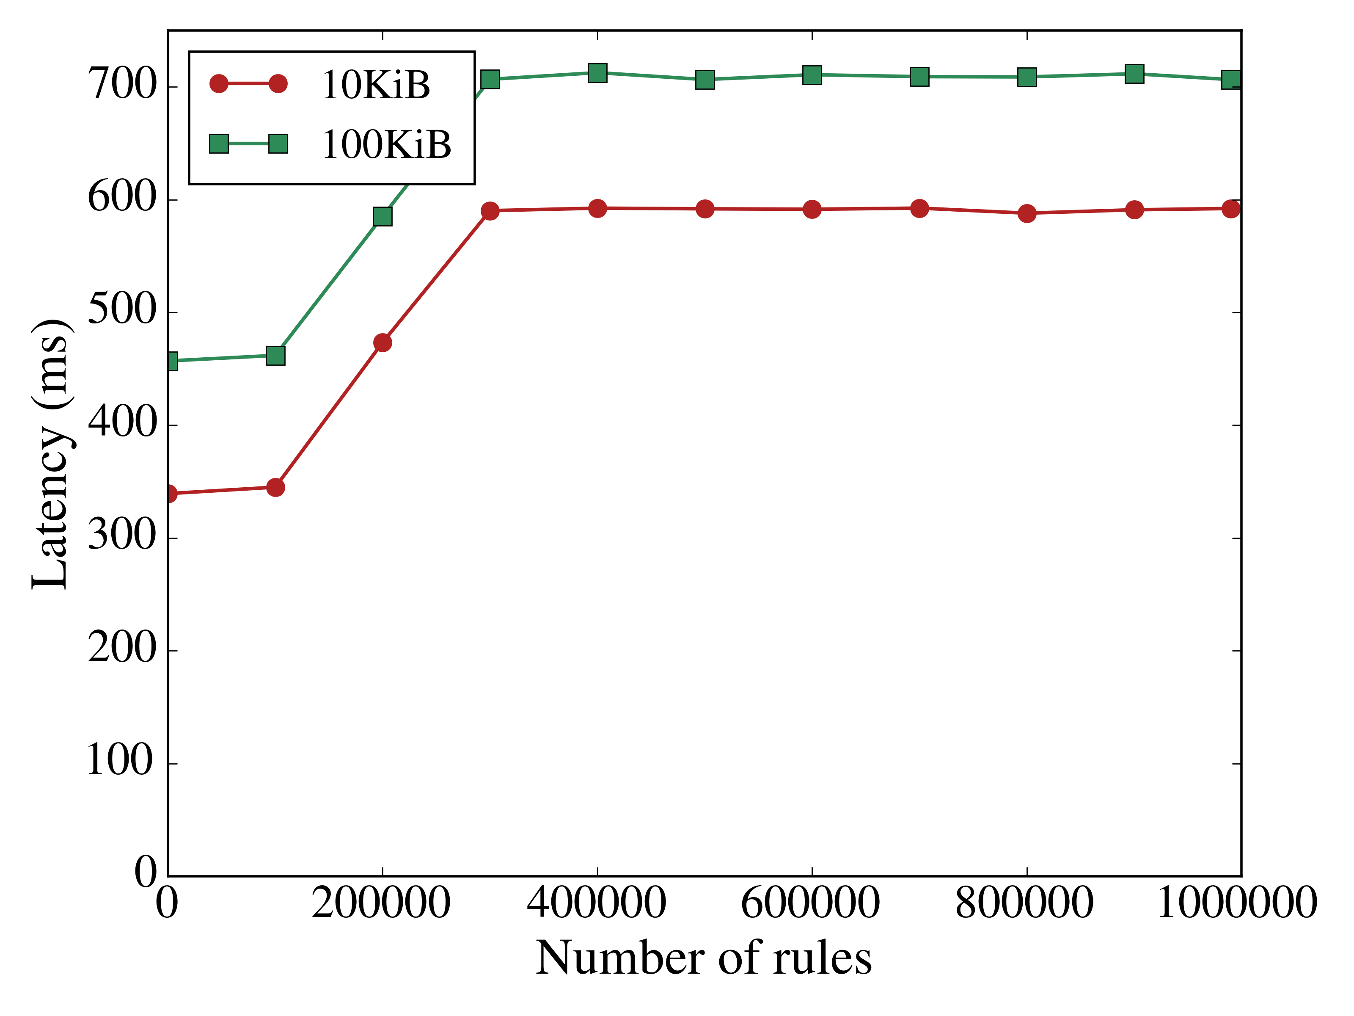
Scalability: Latency per # switch rules

Slide 73
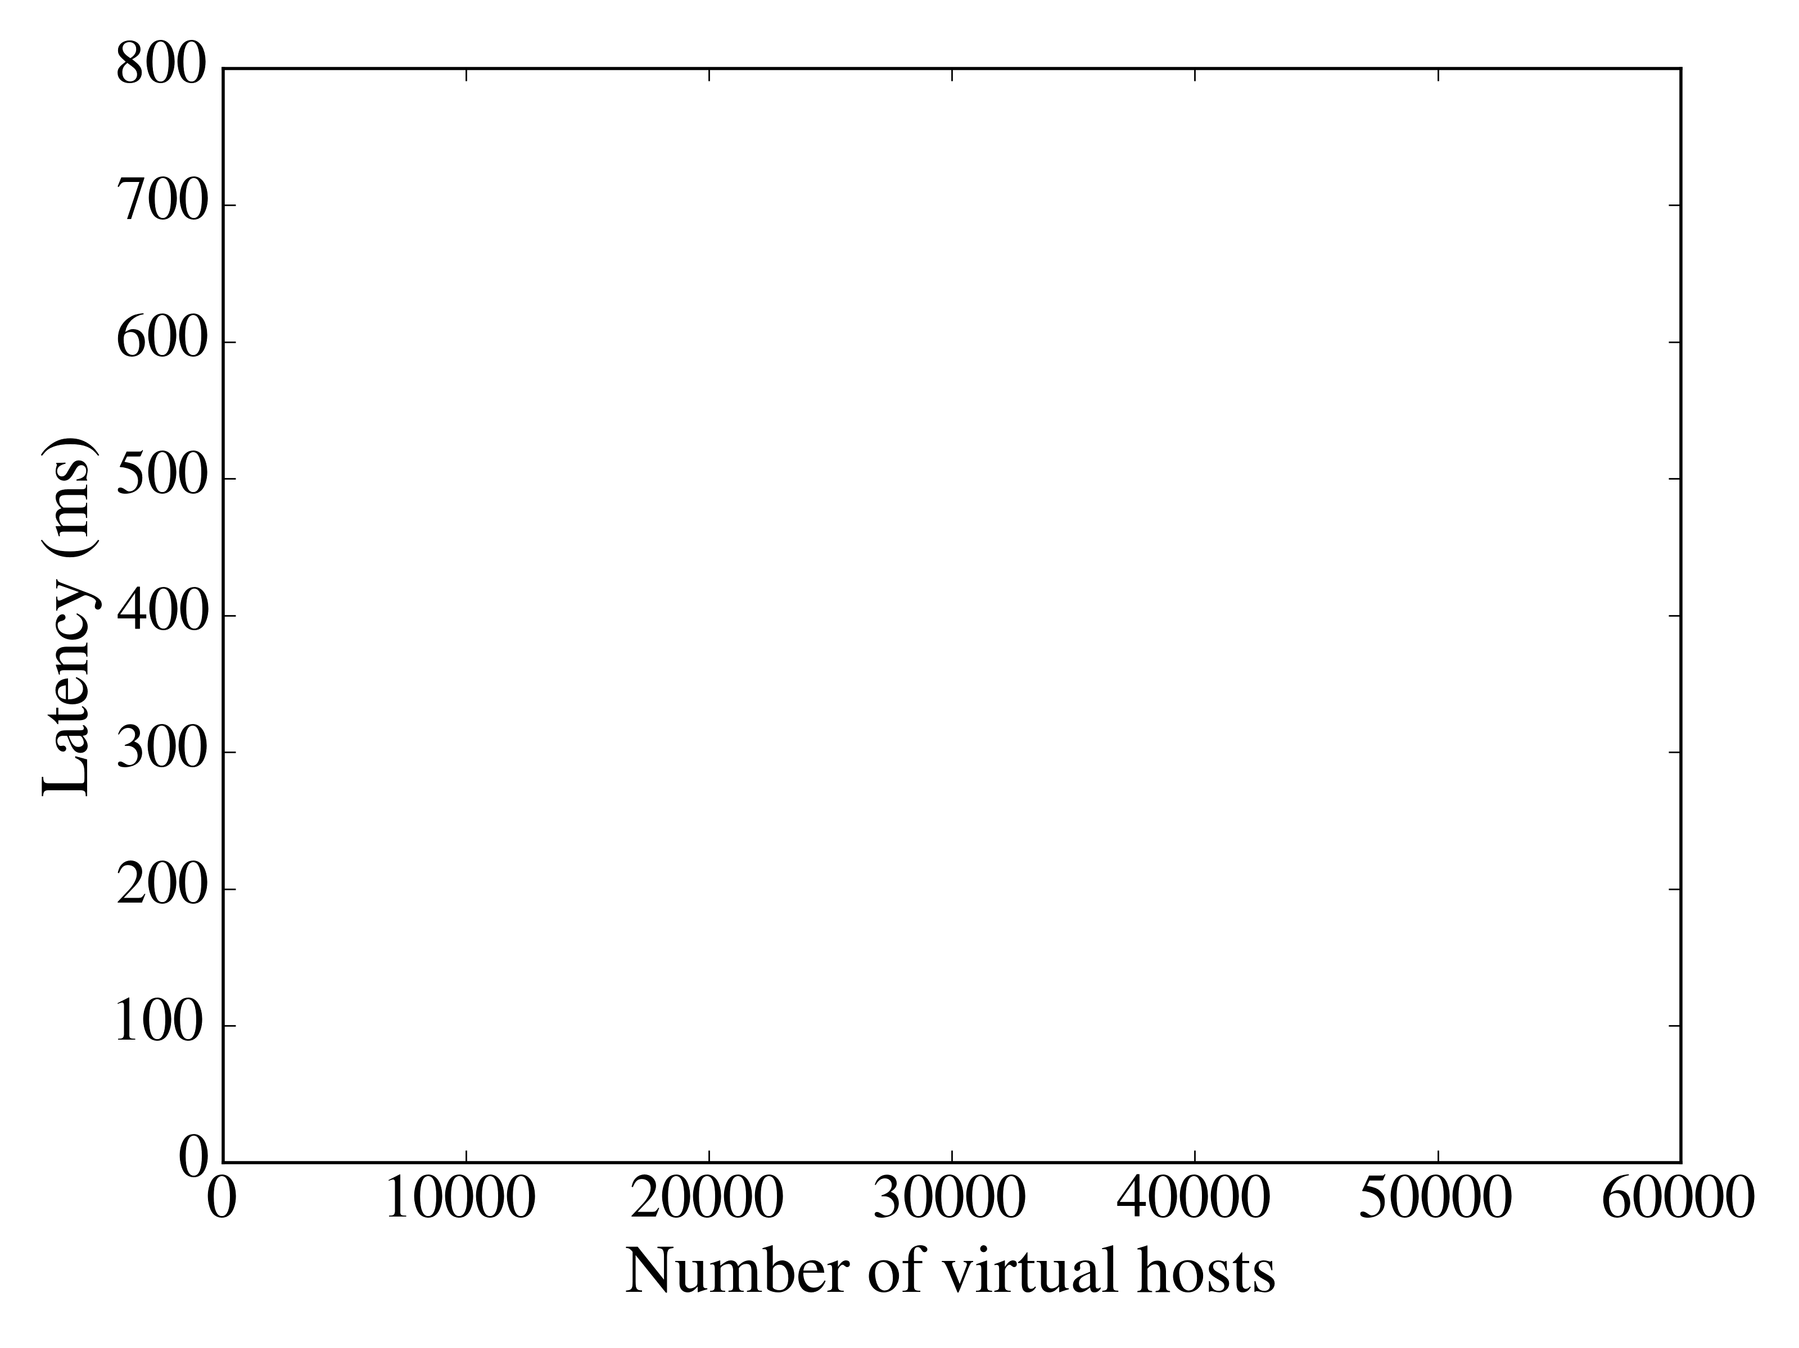
Scalability: Latency per # PoPSiCls for one server

Slide 74
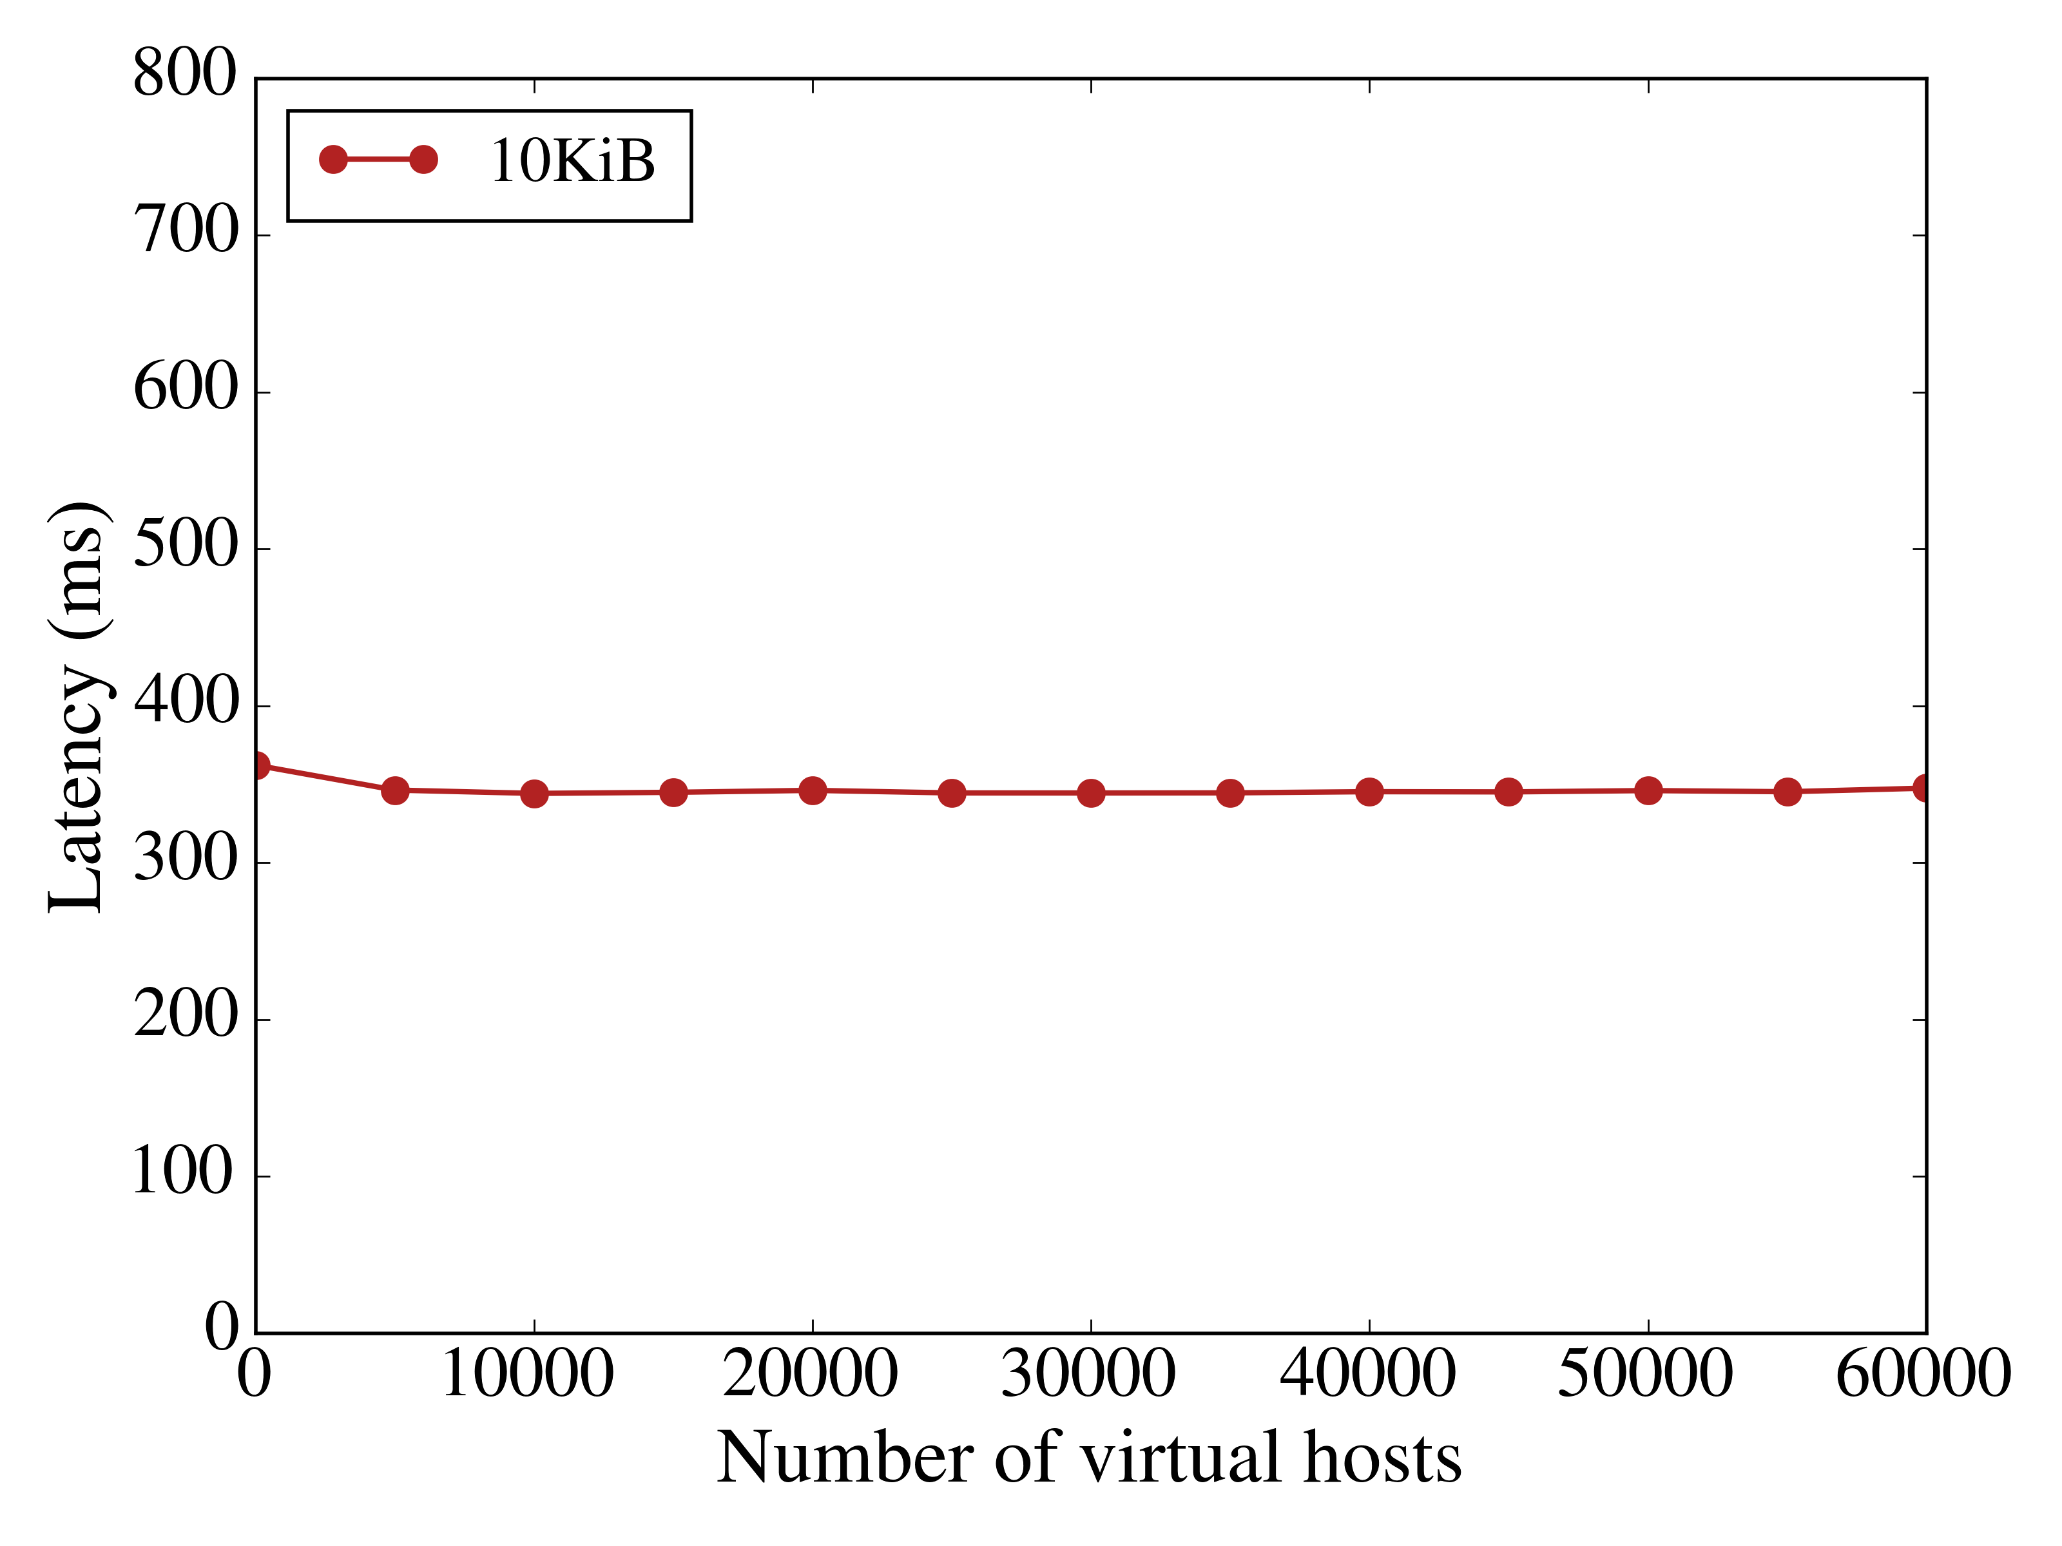
Scalability: Latency per # PoPSiCls for one server

Slide 75
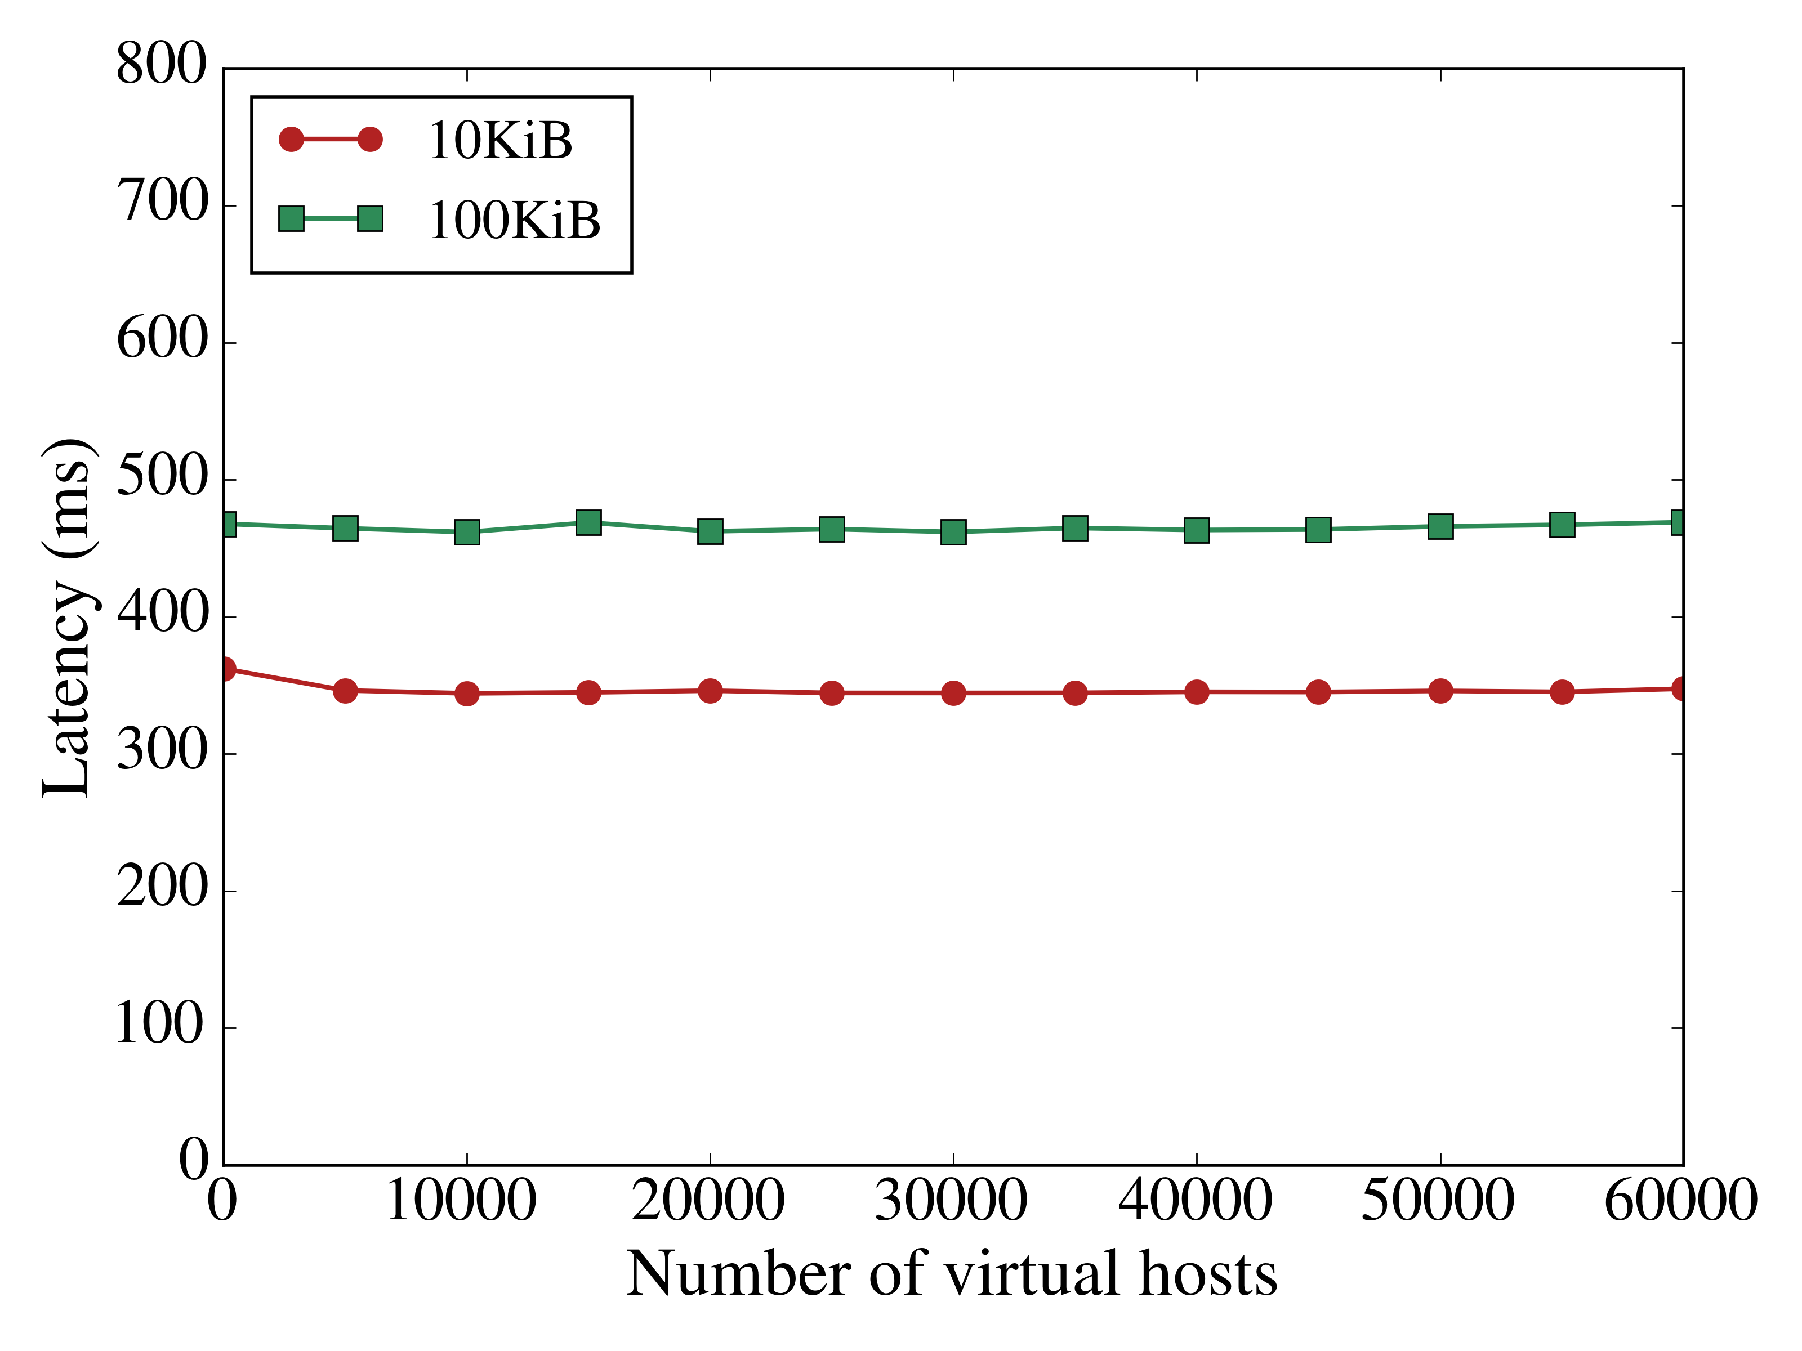
Scalability: Latency per # PoPSiCls for one server

Slide 76

Q&A

